Slide 1
POTS Replacement MACH Networks
January 2023

Slide 2
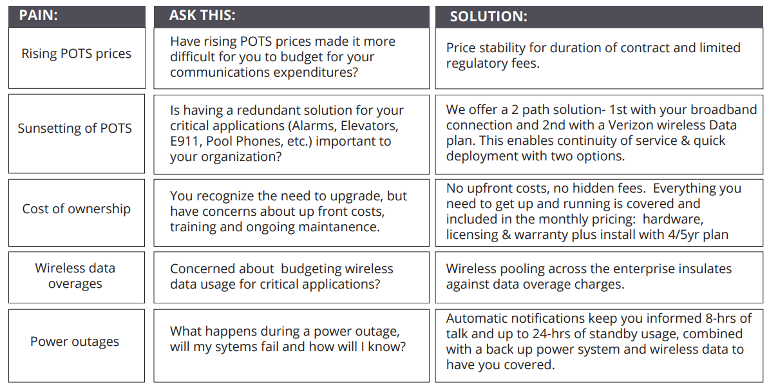
POTS REPLACEMENT – MACH NETWORKS

Slide 3
POTS REPLACEMENT – EPIK vs. MACH

Slide 4
MACH Networks – Operations Issues
How is it deployed in our stores?
Site Assessment – Questionnaire – Configure – Ship – Install – Test – Accept.
MACH Network build sheet provided.
What standards it meets to be accepted as fire burglar or alarms, elevator service line?
It is compliant with NFPA 72 and each component has its own UL certification.
Some level of details on the equipment that would be mounted at the site
We have images. (Closed box on wall – Paul to work with Clayton to locate)
Who would provide the maintenance and support for the equipment?
MACH with BullsEye’s oversight.
Optional Monitoring
MACH provides monitoring with notification to BullsEye to troubleshoot. Can provide customer contact if needed but prefer to have Bullseye be point of contact.

Slide 5
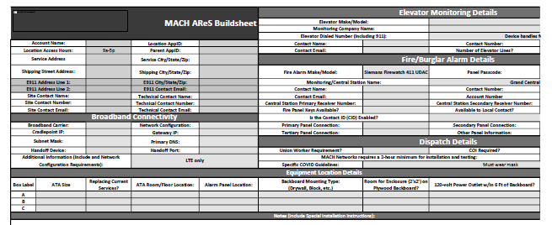
MACH Build Sheet

