Slide 1
Cloud Phone
John Lachance, Sr. Solutions Engineer John.Lachance@Lingo.com
Austin, TX
Information Presentation

Slide 2
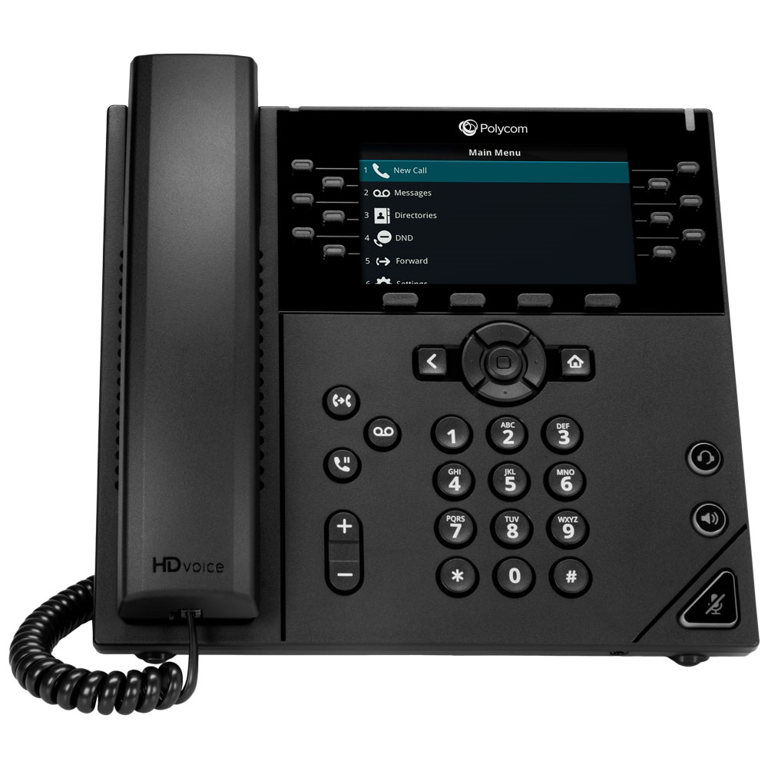
Cloud Phone System
High-Definition Voice
Auto Attendant
Simultaneous Ring
Mobility - iOS and Android App
Remote Office / Home Office
Voicemail-to-Email
Music on Hold
Online Web Portal
3-way Conference
Personalized Greetings
Corporate Directory
Flexibility & Scalability

Slide 3
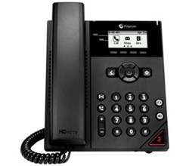
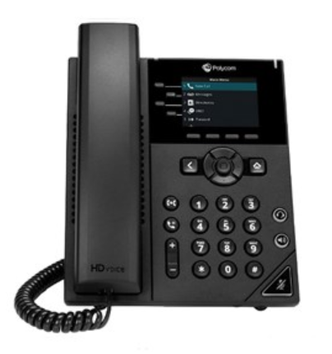
New Polycom Models!
4 Line Appearances
2.8” Color LCD
PoE Support
Dedicated RJ-9 headset port
Busy Lamp Field
USB Support
HD Audio/Entry Level
Acoustic Clarity Technology
Two-port 10/100/1000 Ethernet switch
2 Line Appearances
2.5” Monochrome Display
PoE Support
Dedicated RJ-9 headset port
Busy Lamp Field
HD Audio/Entry Level
Two-port 10/100
10/100 Base-TX across LAN and PC ports
4/9/18

Slide 4
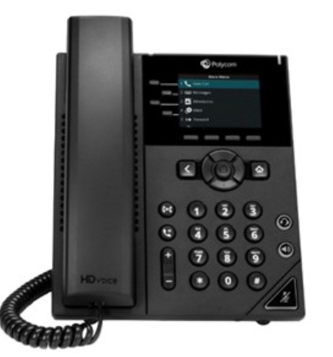
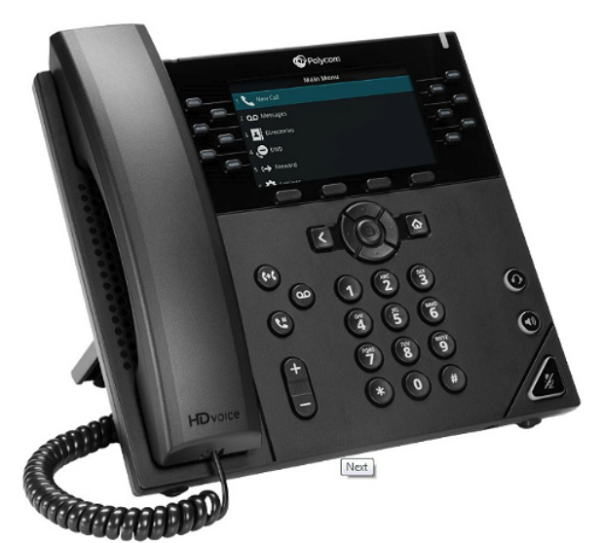
New Polycom Models!
6 Line Appearances
3.5” Color LCD
PoE Support
Dedicated RJ-9 headset port
Busy Lamp Field
HD Audio/Mid Range Performance
Acoustic Clarity Technology
Two-port Gigabit Ethernet switch
10/100/1000 Base-TX across LAN and PC ports
12 Line Appearances
4.3” Color LCD
PoE Support
USB Support
Dedicated RJ-9 headset port
Busy Lamp Field
HD Audio/High Performance
Acoustic Clarity Technology
Two-port Gigabit Ethernet switch
10/100/1000 Base-TX across LAN and PC ports
4/9/18

Slide 5
New Yealink Models!
Yealink T53
Yealink T54
12 Line Appearances
3.7 Inch Monochrome Display/Backlit
PoE Support
Dedicated RJ-9 headset port
Busy Lamp Field
HD Audio/Entry Level
Dual-port 10/100/1000
16 Line Appearances
4.3 Inch Color LCD/Backlit
PoE Support
Dedicated RJ-9 headset port
Busy Lamp Field
USB Support
HD Audio/Entry Level
Two-port 10/100/1000 Ethernet switch

Slide 6
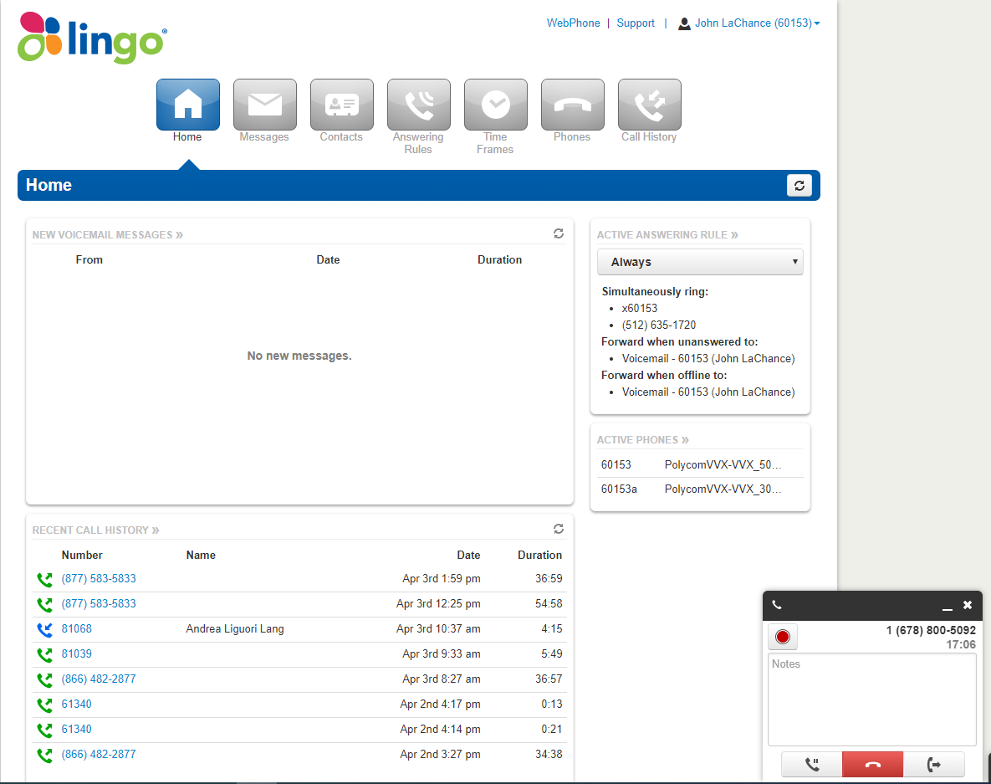
Lingo Connect Online Portal

Slide 7
Lingo Connect Online Portal

Slide 8
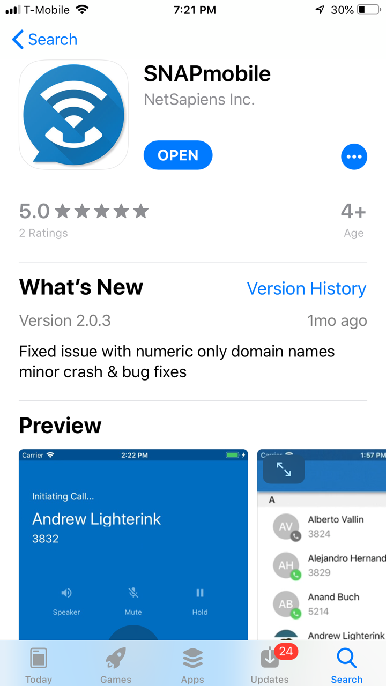
Snap Mobile Smartphone App!
New “native” app for smart phone
Easy to download: Apple IOS “App Store, Android Google Play”
Imports Domain Members
Pulls from existing Contact List
Voice Mail /Text Translation
Private Messaging between Domain Members / SMS coming
Create Greetings/Better Portal Int
More…

Slide 10
Call Center Solution
Call Center Solution is a great fit for SMBs and SMEs who have:
Any number of agents who managing inbound calls, either part-time or full-time
Inbound or Outbound voice only business need
Multiple queue and inbound telephone numbers
Single to a few call center locations
No CRM/ERP integration requirements
Customer Service Centers
Reservations Centers
Help Desks
Consulting and Technical Support
Order Processing

Slide 11
Feature Summary
“Skills-based” Routing
Flexible Queueing and Callback Option/Multiple Queue Assignment
Hoteling aka “Hot Desking”
Customized Audio Greetings and Announcement
Call Center Agent and Call Center Supervisor Portal View
Real-Time Statistics and Reporting
Auto Answer and Threshold Alerts
Listen, Whisper and Barge-In for Supervisor
Queue Call Recording and Optional User-Level Call Recording

Slide 12
Call Center Advantages
Reliability and experience
Disaster recovery
Same great features of standard Hosted offering
Flexibility and scalability
Multi location support
Stable netsapiens® platform
Web based portal for *Agent and *Supervisor login
Powerful reporting and analytical tools

Slide 13
Thank You
Charles Creel – Regional Channel Manager
John Lachance – Senior Sales Engineer

