Slide 1
POTS Replacement - FLS
Sales Version
September 2022

Slide 2
Agenda
POTS Replacement for Today’s Business
Features and Benefits
What’s Included?
Business Rules
SPIFFs
How to sell POTS Replacement for FLS
Market Comparisons
Quoting POTS Replacement for FLS

Slide 3
POTS Replacement
Companies trying to mitigate the impact of FCC regulation, and experience significant cost savings are making a move to our POTS Replacement.
Enable your existing Fire, Life & Safety (FLS) lines & equipment to communicate via IP and cellular networks with our POTS Replacement solution.

Slide 4
Central Office in a Box
Fax lines, security systems, fire alarms, elevators, modems, ATM, emergency call boxes, point of sale systems and more typically required POTS lines adding cost and complexity.
Reduce expensive capex investment.
Create immediate significant savings.
Streamline your business infrastructure.
Future-proofed against sun-setting POTS lines and fully programmable for flexibility with existing hardware.
Virtually every application that requires a copper hardline can now be replaced with a POTS Replacement solution.
POTS Replacement
LTE Primary & Failover
POS & Elevator
UPS Backup
Fax, Alarm, & Gates

Slide 5
POTS Replacement Benefits
Cost Savings: The cost savings can range from 30-50% when compared with traditional copper analog lines.
High Performance: Enterprise-class 4G LTE-driven connectivity. Improve performance and reliability for mission-critical applications, including life safety, monitoring, HVAC, and many more.
Latest Technology: IP-based solution designed to provide mission-critical connectivity for the foreseeable future.
Fully Managed: Fully managed solution that is activated, configured, and monitored by trained professionals to ensure uptime is maximized and data overages are reduced.
Compliant: FCC approval as a life safety connection and carries UL listing and approval.
Notes:
Fire codes very state by state, even county and city by city (NY does NOT allow VoIP for fire, neither do sections of California)

Slide 6
Key Features
Scalable
Supports up to 24 POTS lines per location for ultimate scalability
Automated and secure provisioning
Supports T.38 Fax for reliable FAX over IP
Remote Management for monitoring and troubleshooting
LTE as primary
UPS back-up for continuous uptime.
Uptime Reliability
Fax Support
Notes:
Handoff is via 66 block NOT RJ-11, no encryption (that is a function of the cradlepoint, not MACH’s VoIP. There are no customer usable ports in the MACH solution.
Broadband is optional

Slide 7
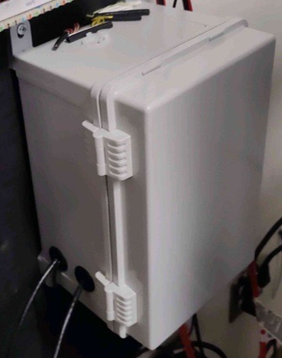
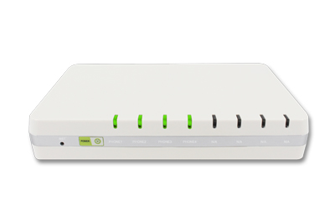
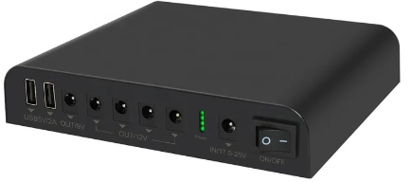
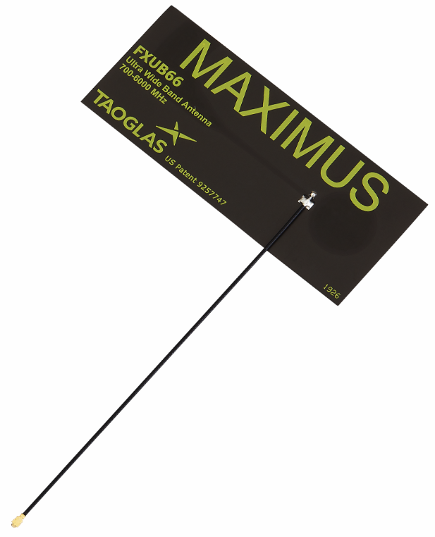
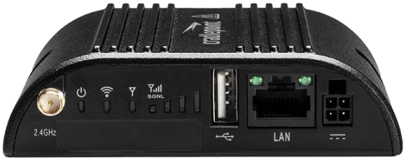
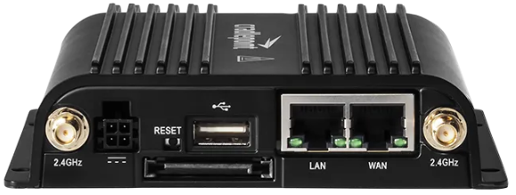
The MACH Solution
AReS Enclosure
MACH Solution is housed inside a 12“ L x 9“ W x 7"H enclosure
Battery Backup
Cradlepoint
IBR200
60 Mbps Throughput
10/100 ETH LAN
4G WAN
IBR650C
75 Mbps
GB ETH LAN
4G WAN + GB ETH WAN
Wireless SIM
ATA
FlyingVoice G504
4 Port
For 2 and 4-port applications
FlyingVoice G508
8 Port
Ultra Wide Band Antenna
Connected to the antenna array for each Cradlepoint

Slide 8
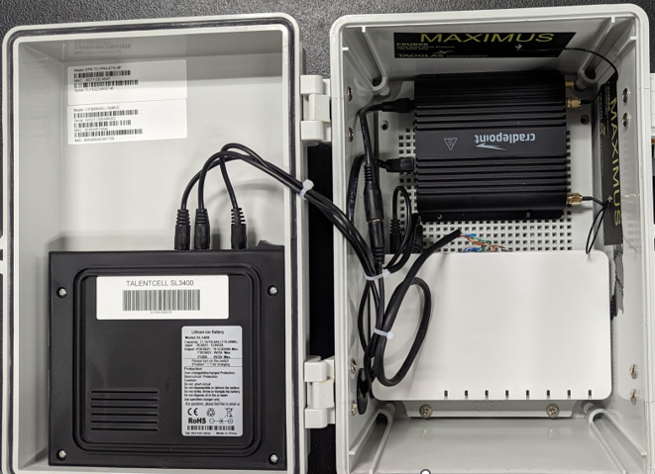
How it Connects
Wireless Antenna
4G Modem
ATA
Battery Backup
Notes:
Handoff is via 66 block

Slide 9
What’s Included?
Equipment
Cradlepoint IBR200 4G Modem and ATA
2 seat configuration
-or-
Cradlepoint IBR650 4G Modem and ATA
Supports 4-8 seats
Purchase (up front or amortized) or Lease
Battery back-up included at no additional cost
Seat License
FLS (Fire, Life, Safety) Seat
Wireless Access
LTE Wireless Data SIM and plan per device
*All pricing is 3yr. Term. Wireless Access Plan has overage per gig of $19.50 per Gb.
Equipment | Purchase (One-time)
IBR200 (2-seat) | $511.54
IBR650 (4-seat) | $575.64
IBR650 (8-seat) | $832.05
All inclusive
MACH provides:
ATA
DIDs
Wireless plan
Everything listed on this slide
License (per seat) | Purchase* | Lease*
be-Alert Seat License | $29.99 | $39.99
Wireless Access (per device) | Purchase* | Lease*
LTE Data Plan | $25.96 | $46.99
Notes:
Only sell for FLS lines – not Voice – quote Integrated Voice instead. New lines or port/lnp for existing lines.
CP200 line – will only be offered for 2-line deployments, 4-8 will be CP650
Wireless Plan is chosen by MACH, regardless if it is 2GB or 3GB, it is the same price to the customer (as well as cost to us).

Slide 10
Additional Charges
Installation (per device) | Charge (one-time) | Amortized*
Standard Install (2-port) | $251.95 | $7.00
Standard Install (4-Port) | $366.45 | $10.18
Standard Install (8-Port) | $595.55 | $16.55
Optional Antenna Extension | Charge (one-time)
Antenna Extension Equipment | $229.95
Turn-Key
Order and MACH handles the rest
MACH does the installation – not us.
Regulatory | Charge (monthly)*
VoIP Recovery Fee | $2.00
* 3-year term only

Slide 11
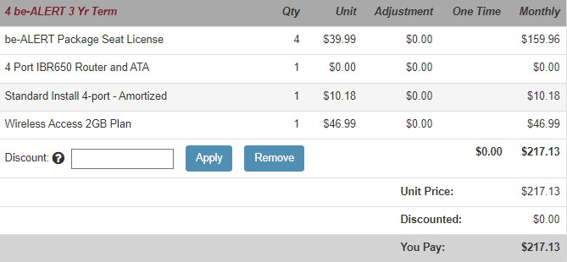
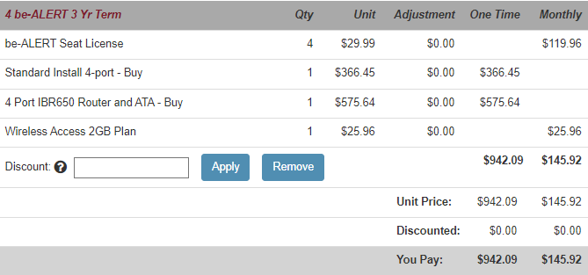
4 Seat Pricing Scenarios
Equipment Purchase Example
No CapEx Example (Lease)
Notes:
Update screen grab to have CP650 for 4 line deployment

Slide 12
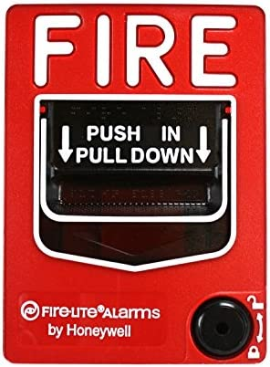
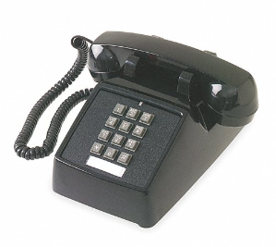
Use Cases
Allowed | Not Allowed
FLS | Voice lines
Fax | Lobby phone
Elevator | Push button at entrance
Pool phone
√
Notes:
Give Clayton this slide to cover

Slide 13
Meeting Customer Needs
Applications:
Displacement of the LEC (price, coverage, capability).
Compliment BullsEye’s VoIP offering, taking over lines traditionally left behind with the LEC (Fire, Safety, Elevator, Fax, etc.).
Available Options:
BullsEye VoIP – Hosted or SIP, Plus...
POTS Replacement FLS– no voice support
Evaluation:
Current POTS Costs – Local Lines, Usage, Regulatory.
Price Volatility (future price changes).
Access Method – Broadband, Wireless, Both.
Technical Capabilities
Difficulty with VoIP application.
Copper Retirement, High-Cost Fiber.
RAY BAUMS Act compliant – similar to BullsEye VoIP Solution.
Notes:
Mention NO VOICE SUPPORT

Slide 14
FLS POTS Replacement versus LINC (CableCo POTS)
Underlying provider coverage may dictate which solution to lead with.
i.e., LTE coverage versus Spectrum/Comcast/Cox coverage
LINC takes longer to deploy, due to qualifying/installing the service on the underlying provider’s network
LINC – Not compliant with RAY BAUMS Act.
Can more easily add lines under LINC versus FLS POTS Replacement.
FLS POTS Replacement supports dual WAN connections for redundancy
If LINC goes down, it’s down.

Slide 15
Market Comparisons
4 Seat 3yr. Term – Fire, Life, Safety
BullsEye – POTS Replacement – FLS (including install)
$43.01 per seat ($172.04 total solution)
Granite
$46.24 per seat ($184.96 total solution)
CSG
$49.95 per seat ($199.80 total solution)
MetTel
With Install MRC Included = $30.48 per seat ($121.90 total solution)
Company | Avg Seat MRC | Percent Difference
BullsEye | $ 43.01 | --
Granite* | $ 46.24 | 6.98%
CSG* | $ 49.95 | 13.89%
MetTel* | $ 30.48 | -29.14%
Important*
Granite: Markets pricing less the install ($199).
CSG: Markets pricing less the wireless plan.
MetTel: Includes install and site assessment in their MRCs. Differences include: Broadsoft integration, latency tendencies, call set-up and usage.
Note: Competitive intel is still limited, learning daily. Will provide updated comparatives when available..
Notes:
Epik does not offer a single-seat solution whereas we do!

Slide 16
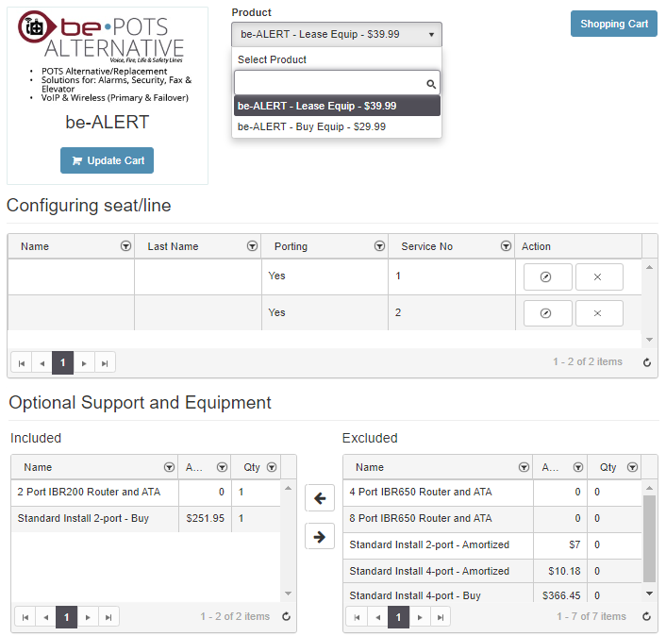
Quoting POTS Alternative - FLS
(This will be changing in BOSS as we move away from “be-” product branding)
Seat pricing under Lease or Buy
One-time Install Charge or Amortize

Slide 17
Important Points
It Is extremely critical that the information provided on the “Pre-Site Questionnaire / Build Sheet” be 100% accurate and confirmed with the customer
MACH does the installs and they do not have access to any information we do not give them
You should NOT be completing this on your own. A Sales Engineer is required on all MACH orders, they can help you with the PSQ / BS and will create the SOW we submit to MACH
Take an extra day or two to get the correct information up front to prevent long delays and re-quoting down the line
Failure to have correct info will result in failed deployment and additional installation cost to the customer as well as order delays
Any changes to the order once MACH technician is on-site (adding lines, removing lines) will result in deployment failure and RTS for re-quote, as well as additional install costs and order delays
If a customer is unsure about the number of lines, fire / alarm panel type or any other required info on the PSQ / BS, it is suggested that a TSaaS site survey be ordered so the TSaaS tech can confirm the info on the PSQ / BS before MACH deploys
Any RTS for incorrect information or line counts will result in the customer paying for the failed deployment and will require re-quoting in BOSS.
This will cause significate order delays as well
During Lean Launch ~85% of orders had on-site changes and while we were able to pivot in the LL environment, we will not be able to in general release, orders will be failed and RTS for requoting, re-submission to MACH, and additional site visits
Notes:
We will no longer except non-POTS class of service order. Need to quote a different solution or have the customer convert the line before bringing it to us.

