Slide 1
Serenity Broadband Solutions
for [Company Name}
SM
TM
Powerful broadband solutions to help you provide your customers {specific benefit to customer].
2/9/2023

Slide 2
Lingo + BullsEye
Cloud/UC and Managed Service Provider serving 130K+ globally diversified customers
350+ Employees
Executive Leadership with Over 135+ Years of Combined Technology Industry Experience
Award Winning Leader for Cloud Communications, SD-WAN, Security, Internet & POTS
130K+ Clients Across Three Segments:
Business, Carrier & Consumer
Voted Top 2021 VoIP Solution Provider by Telecom Tech
Diversified Client Portfolio Representing Over 15 Verticals
Over 20 Years of Exceptional Client Service
130K+
135+
20+
Years of
Industry
Experience
Years of
Client Service
Excellence
Customers

Slide 3
Proven Business Model
Revenue Stability and Diversification: Combined revenue segments (Business, Carrier and Consumer) are diversified across all industries including medical, business services, legal, technology, transportation, and more.
Cloud UC & Managed Network Infrastructure: Cloud UC and Feature Group D (“FG-D”) networks in the U.S. and Canada which process over 18 billion minutes of traffic annually.
Diversified Plan: Our growth is focused on organic strategic initiatives. (new business, cross-selling products, international growth). Plus, there will be acquisition opportunities.
Together we have a strong foundation and are poised for continued growth.
Business
Carrier
Consumer
2022E
~$240M+
130K+ Clients Across Three Segments:
Business, Carrier & Consumer

Slide 4
The Difference We Deliver
Dedicated Steadfast Support
Exceptional Service Delivery
Remarkable Consistent Reliability
Unwavering Client Commitment
Simple Pricing Model
Project Management (“White Glove Service”)
Our Own Proprietary Nationwide Network
Industry Experts in Cloud Communications/VoIP
Trusted Advisor for Businesses of All Sizes
Highly Skilled, Tenured Client Care Team
Dedicated Professional Installation, Service and Activation
Operations Located in Dallas, TX; Atmore, AL; Macon, GA; and Southfield, MI.

Slide 5
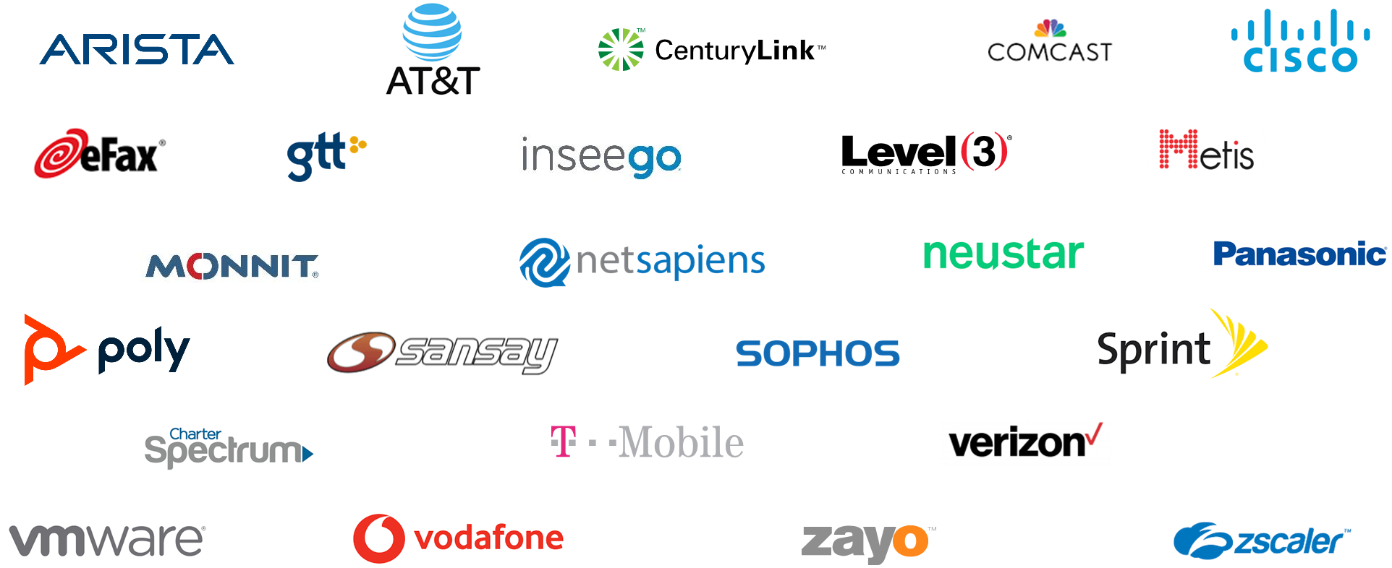
Partnerships with the Industry’s Best

Slide 6
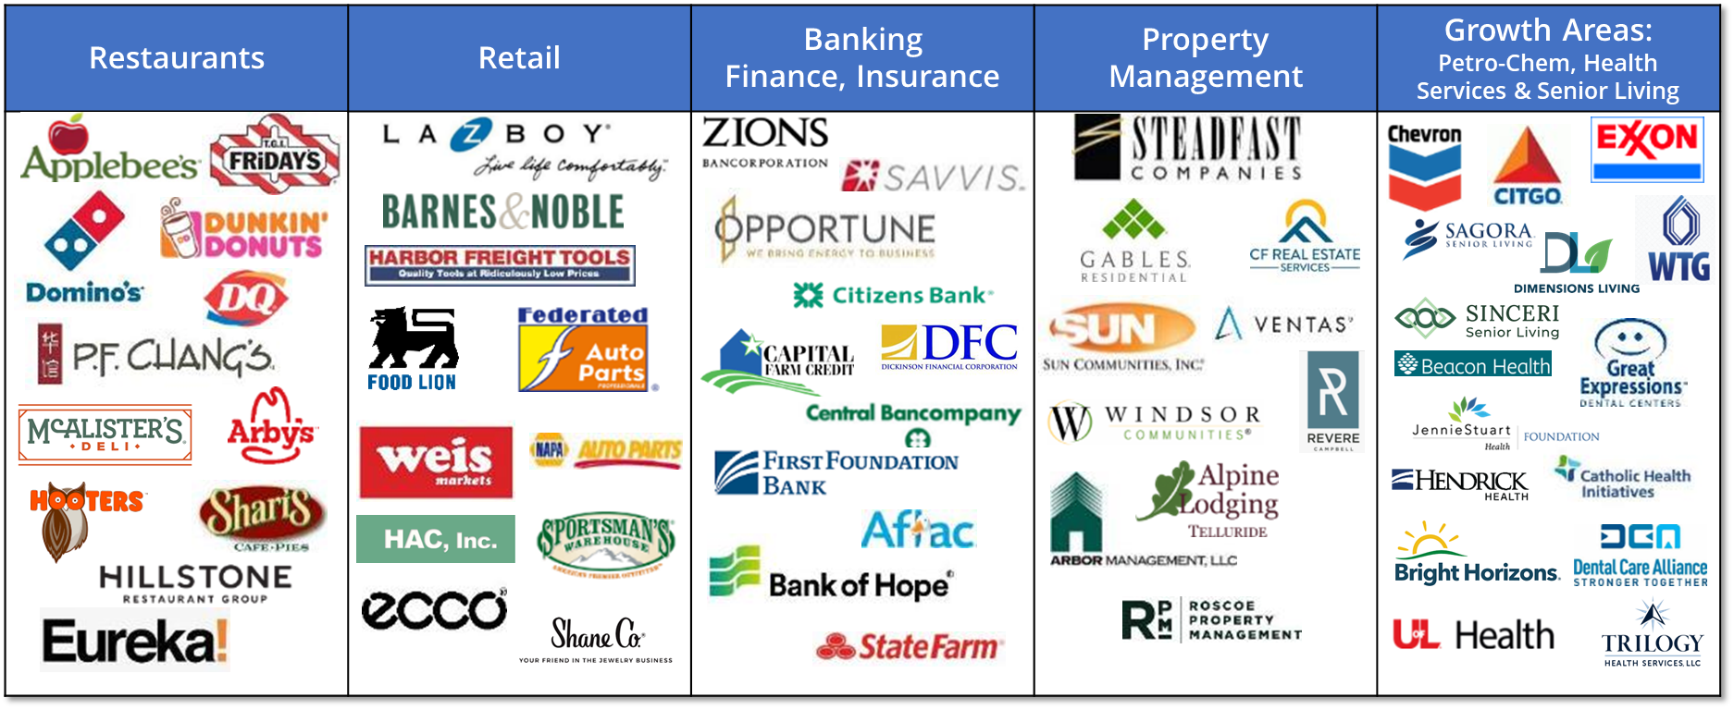
Trusted by the Best

Slide 7
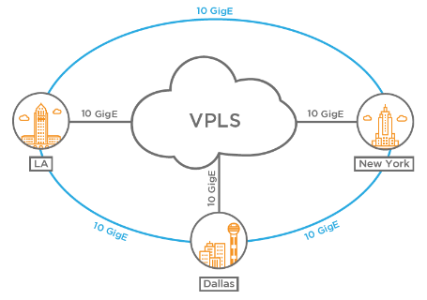
Robust Nationwide Infrastructure
Cloud UC & Feature Group D Network
North American Network Key Highlights
Modern, efficient, IP-based cloud and managed services structure that is positioned for future growth
U.S. Coverage Statistics:
171 of 194 LATAs in U.S. and Canada (88%)
417 of 1,100 Tandems (38%)
22,000 of 32,000 End Offices (67%)
121,000 of 154,000 NPA/NXXs (79%)
Net Sapiens and Broadsoft Cloud / UC Networks:
Cloud Switches and Cisco Redundant Router Backbone
50% Utilization of Cloud Network Allows Growth with Min. Capex
North American (U.S. & Canada) FG-D Network:
Terminates Traffic to 88% Of U.S. and Canadian LATAs
60% Utilization on FG-D Network Allows Growth with Min. Capex
Carries Over 18 Billion Minutes of Traffic Annually
NNI With GTT And Others Provide National Broadband / Fiber Access
SD-WAN and Managed Network Services Assures Reliability
24/7/365 Network Monitoring & Tech Support
Los Angeles switch site
Dallas switch site
New York switch site
Core Backbone Network Across Cloud and FG-D
.

Slide 8
9 Million Business Buildings within 1,000ft of Fiber

Slide 9
Full Nationwide Broadband Reach: Fiber, Cable, Wireless
Reselling Connectivity from 20 Carriers, 400 Product Speeds
10Mbps to 10Gbps Speed and increasing
Easy Near Real-Time Qualification Tools
Deliver the best dedicated Fiber DIA product in US backed by SLA
Forever increasing reach, adding new providers
Wireless backup for resilience
Forever pressing for lower rates to improve competitiveness
Fiber and 5G Wireless is the future
Currently assessing carrier and device options for 5G,
and checking SD-WAN compatibility
Expect to add more fiber vendors in 2023

Slide 10
Discover The End-To-End Experience of Serenity^{tm}
No one takes your service delivery and service assurance
more seriously than Lingo.
Flexible Solutions
We give you flexible broadband options that may include shared wireless, fiber optic, Ethernet or DSL facilities, IP assignment, and transport of your end-user data traffic from the premises to the public internet.
The best service delivery in the industry
With 20+ installing and managing applications of every size, our project management and operations teams have earned customer satisfaction scores 30% above industry average. Ask for our white paper on customer satisfaction.
Your rates are guaranteed.
All of our 36-month agreements guarantee your rates for the entire term.
Our exclusive broadband delivery guarantee
If we cannot provide a new solution of our own at a location we will project manage and install another solution for you, or retain your current service and we will simply re-bill that service.
Industry-leading service level agreements (SLAs)
Serenity Broadband Solutions have exceptional SLAs that far exceed the SLAs of many other providers.

Slide 11
Direct first-hand Quote from Enterprise customer on 12/7/22 whilst negotiating new pricing and agreement with us:
“We have Aggregators coming to us all the time and we have only retained Bullseye because of all the additional benefits and creativity we bring”
OK - 36Mth Automatic Rate Guarantee if select 36Mth term
OK - Commercial SLA on all Dedicated Fiber Circuits
Should we include or aspirational? For Any New Circuits – A Construction Discounter – the Early Disconnect Protection funds can be used as Escrow to subsidize construction costs for new site location circuits. If renew contract at end of term, remaining Escrow moves on into new contract.
OK - Broadband Delivery Guarantee – if we cannot provide a new solution from one of our own at a location:
we will project manage and install someone else’s solution for you, or
retain your current service by us simply re-billing that circuit

Slide 12
Dedicated Support for Fisher Auto Parts
Your Client Experience Team
Brief description here.
Your Tech Support Team
Brief description here.

Slide 13
Your Dedicated Executive Management Team
Elizabeth Parks - PM
Director – Corporate Accounts
eparks@bullseyetelecom.com
248-784-2659
Paul Bockstanz
Account Manager Supervisor
pbockstanz@bullseyetelecom.com
248-784-2535
Christopher Ramsey
Chief Revenue Officer
Chris.Ramsey@lingo.com
470-401-0040

Slide 14
Broadband Excellence Q&A
1/19/23

