Slide 1
Defining a Winning Combination

Slide 2
Lingo Evolution
Lingo has Successfully Executed on Multiple, Value Accretive Acquisitions
Inception
Acquisitions
Acquisitions
Birth of Lingo
Fusion Connect Acquisition
Company is incorporated as Access Integrated Networks.
2007: IDT
2008: Birch Telecom Inc
2008: Navigator
2009: Cleartel Comm.
2011: Cordia USA
2012: AstroTel
2012: dpiTeleconnect
2012: Daystar Comm.
2013: Globalinx
Birch Communications spins its SMB and Consumer assets out creating Lingo Management in May 2018.
Lingo acquires 3,600 SMB customers from Fusion Connect, the second tuck-in of Lingo’s rollup strategy.
2005-2006
2010-2011
2013-2016
Dec 2018
2022+
1996
2007-2009
2011-2013
May 2018
Feb 2019
Acquisitions
Acquisitions
Acquisitions
Impact Telecom Acquisition
BullsEye Acquisition
2005: Cinergy
2006: Trinsic Comm.
2006: Sprint Local
2010: Freedom USA
2010: American Fiber Net
2010: Close Call America
2011: Accutel
2011: Cordia Int’l
2013: Lightyear Comm.
2013: Ernest Comm.
2013: Covista
2014: Cbeyond
2016: Primus Canada
Lingo acquires Impact Telecom in Dec. 2018, the first tuck-in of Lingo’s rollup strategy.
Lingo acquires Bullseye Telecom in Aug 2022, adding substantial business customers and revenue to its robust platform.
Becomes a B. Riley company
Source: Company materials

Slide 3
Lingo Overview
Cloud/UC and Managed Service Provider serving 114K+ globally diversified customers
Business Overview
Revenue by Business Segment
Headquartered in Southfield, MI
  Operations in Dallas, TX; Atmore, AL; Macon, GA
Cloud/UC and Managed Services Provider
114k customers across three market segments
SME customers are diversified across industry (business services, technology, transport, etc.)
Carrier segment includes top ILECs, CLECs, Cable, and Mobile Carriers.
Cloud UC & Managed Network Infrastructure: Cloud UC and Feature Group D (“FG-D”) networks in the U.S. and Canada which process over 12 billion minutes of traffic annually.
Revenue Stability and Diversification: Combined revenue segments (Business, Carrier and Consumer) are diversified across all industries including medical, business services, legal, technology, transportation, and more.
~330 Full-Time employees
2023E
~$252M
2021E
~$130M
Revenue Stratification by Geographic Region
  88.0% of revenues comes from the 50 U.S. states
  1.0% of revenues come from Canada
  The remaining 11.0% of revenues come from International Carriers

Slide 4
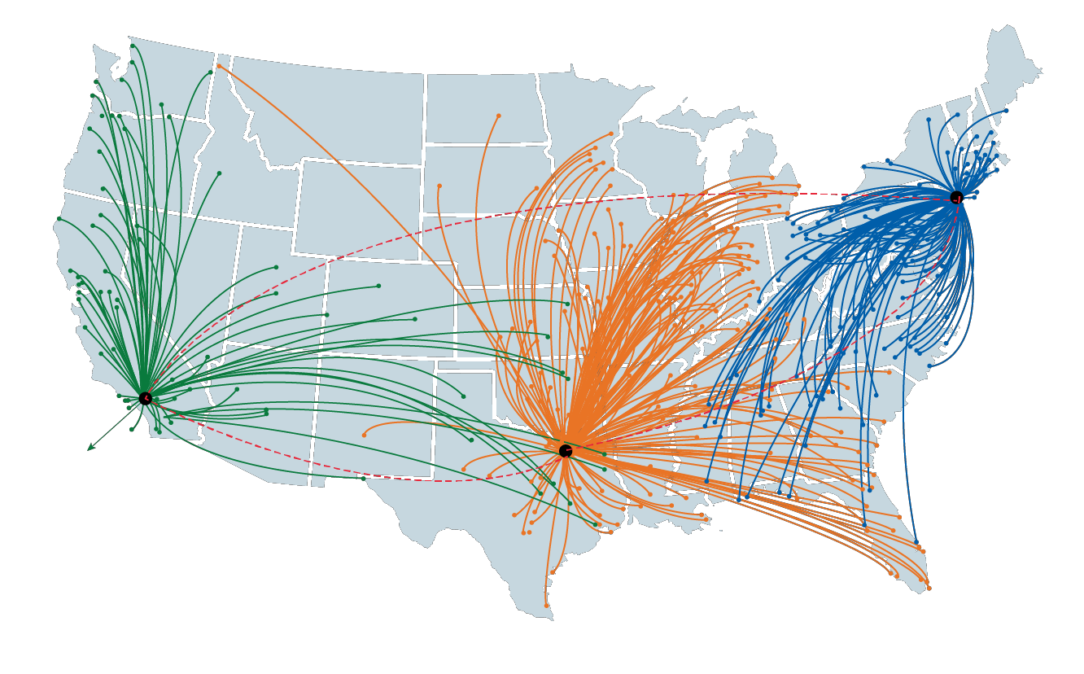
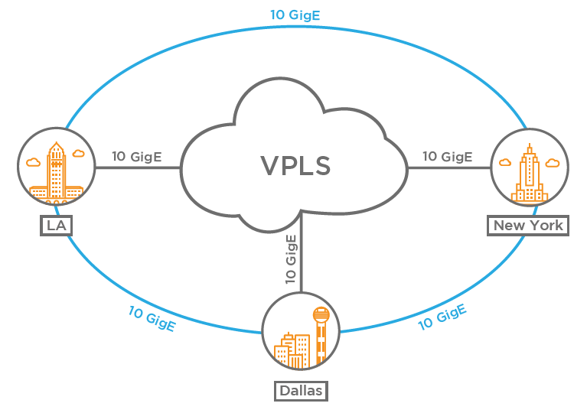
Robust Nationwide Infrastructure
Lingo’s Cloud/UC and Fiber Networks Provides Services for SME and Consumer Customers
Cloud/UC Network Key Highlights
Cloud/UC Network
  Cloud/UC Network:
    Netsapiens & Broadsoft Cloud/UC platform and Cisco redundant router and network backbone
    Network backbone shared with Feature Group-D Network to increase efficiency
    Serves all 50 United States and Canada
    50% current utilization of Cloud/UC network will enable Lingo to add new volume with minimal capex
  NNI Connectivity with many other network partners provides national broadband/fiber access
  Velo Cloud SD-WAN network services assures reliability
Los Angeles switch site
Dallas switch site
New York switch site
Core Backbone Network
Source: Company materials

Slide 5




Nationwide Footprint & Relationships
  Extensive, nationwide network footprint via the Company’s established incumbent carrier relationships
  Fully interconnected in all 48 states and the District of Columbia
  Supplemented by Lingo’s emerging carrier / provider relationships
  Enables nationwide coverage for the delivery of traditional TDM based voice services as well as IP-based Cloud/UC and Managed Services
  Unique, fully interconnected network presence
  Results in multiple connectivity options and cost optimization for Lingo and the end customer
  Comprehensive electric bonding for data exchange
  Facilitates all aspects of seamless order processing, rating, billing, settlement and validation
ILECs
CLECs

Slide 6







Robust Long – Distance (LD/TF) Network
Lingo’s LD/TF Network Provides Services for SME, Carrier and Consumer Customers
LD Network Key Highlights
Feature Group-D Network
  LD Network backbone is shared with Cloud/UC Network to increase efficiency across both networks
  North American (U.S. & Canada) LD Network:
    Terminates traffic to 99% of U.S. and Canadian LATAs via ILEC Central Office Connections
    50% current utilization of LD/TF network will enable Lingo to add new volume with minimal capex
    Carries over 12B minutes of traffic annually
    Provides domestic and int’l LD origination / termination and 8YY services for our SME, Carrier & Consumer customers
  U.S. Coverage Statistics:
  192 of 194 LATAs in U.S. and
  Canada (99%)
  475 of 1,100 Tandems (43%)
  24,000 of 32,000 End Offices (75%)
  131,000 of 154,000 NPA/NXXs (85%)
Los Angeles switch site
Dallas switch site
New York switch site
Key Technology Partners
Core Backbone Network
/
/
Source: Company materials

Slide 7






















































Trusted by the Best
Restaurants | Retail | Banking Finance, Insurance | Property Management | Growth Areas: Petro-Chem, Health Services & Senior Living

Slide 8

















Network & Technology Partners
Cloud/UC
Data & Voice
Wireless Service
Equipment
  More than 50 different network providers enabling nationwide coverage and access
  Best of breed technology partners utilized across Cloud/UC, Managed Services and equipment deployments
Security / Managed Communications

Slide 9



















Partnerships with the Industry’s Best

Slide 10
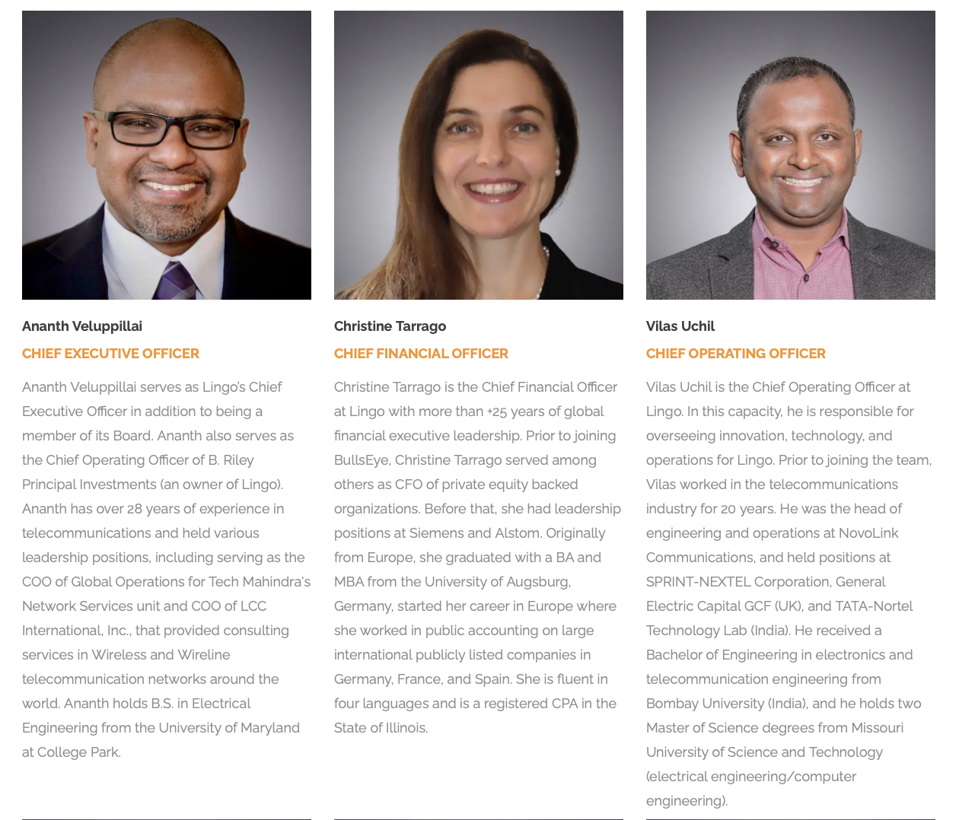

World-Class Leadership with Unparalleled Industry Experience
Source: Company materials

Slide 11
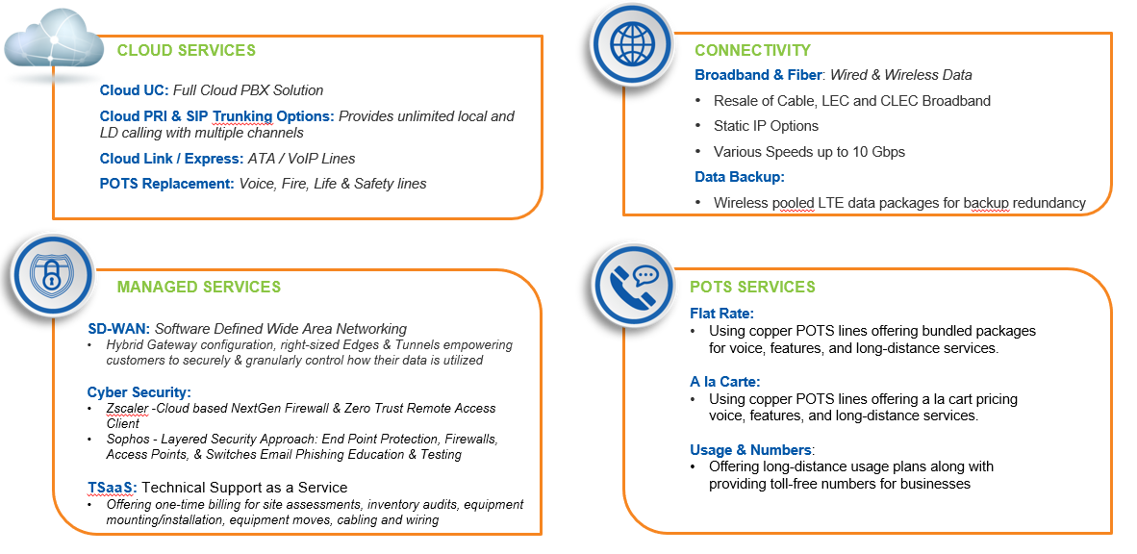
Product Offerings

Slide 12







One-Stop-Shop Solution Provider
Lingo offers a unique, comprehensive suite of communications solutions purpose-built to meet the complex needs of multi-location enterprise and SMB customers across all industries and geographies
Cloud/UC
Cloud Unified Communications
Auto-Attendant
Virtual Number
Digital Voice Portal
MS Teams Direct Routing
Integrated Voice
Broadband Service
Bandwidth Aggregation
Cable
T1
Fiber
SIP Trunking
IP Phones & Hardware
Virtual Phone System
Virtual Receptionist
Fixed Wireless
Wireless Failover
Wireless Internet Access
Traditional Phone Service
Local & Long-Distance Service
PRI
Structured Cabling
Cloud Solutions
Unified Communications
Contact Center
Wireless Failover
Security Services
Managed Services
IP VPN
Audio/Web Conferencing
Managed Router & Firewall
Security
SD-WAN
Audio Recordings
Rebilling
PCI Enablement
Security Services
Cloud Security (Zscaler)
Firewalls (Sophos)
Endpoint Detection Response (Sophos)
Security Awareness (Sophos)
Encryption and Email Security (Sophos)
Online Management Tools
Telecom Expense Management Portal
Support Ticketing
Digital Voice Portal
Reporting

Slide 13



Value Proposition
Lingo leverages its best-in-class nationwide network and robust product suite to deliver a differentiated value proposition to you
With a wide breadth of service capabilities and national reach, Lingo is a single source provider of business communications solutions serving multi-location customers in every part of the United States
SERVICE EXPERIENCE
DIVERSE SUITE OF SERVICES
SINGLE POINT OF CONTACT
Supported by a dedicated team of empowered experts, Lingo provides you with multiple levels of interaction that enable you to monitor your systems in real time, ensuring high quality, reliable network services.
With a deep portfolio of technology solutions, Lingo approaches every network with a focus on understanding unique priorities and business drivers to recommend a solution that is tailored to fit your needs.
Leveraging its deep product set, Lingo is able to provide you with a single point of project management to deploy services, consolidated billing, dedicated support for all services ensuring that you are optimizing within your network.

Slide 14


What Can Lingo-Bullseye Do for You?
The Retail Bundle: Primary/Backup Bandwidth + Over Subscription VoIP+ SD-WAN + POTS Replacement? A no brainer!
  Primary/Secondary (Backup) from over 150 options including pooled and non-pooled wireless options
    Monitoring & proactively supported
  SD-WAN to ensure the best customer experience by enforcing data prioritization, packet steering, redundancy management & an extra layer of security.
    Hybrid Gateways empowers VoIP traffic encryption and prioritization helping position us a premier VoIP provider
  VoIP DECT Phone setup – Over-subscription configuration
    Up to 8 simultaneous call paths on a single Hosted Voice
  POTS Replacement for Fire, life & Safety lines
    Meets all the regulatory codes
  Multi-Location customers see dramatic increases in up time and customer satisfaction with multi-leg SD-WAN deployments ensuring for the best possibility for 100% uptime while delivering an amazing customer experience.

Slide 15
Thank You

