Slide 1
<<Name of the Company>>
<<DATE>>
<<CRM Name>>
<<AM Name>>
<<SE Name>>
Quarterly Business Review

Slide 2
Agenda
Current agreement
Lingo Team
Active and Deactivated services
Invoice History
Ticket history
Trouble Reporting & Escalation
My BullsEye Account Portal – MBA
Key Players - Contact Information
BullsEye Service Offerings
Notes:
Need to add a slide about the Customer’s goals; what’s important to the client? Create conversation

Slide 3
Current Agreement
Start Date with BullsEye:​ | 1/1/21 | App ID:​ (Account #)​ | ​12345678
Term:​ | 2 years | Expiration Date:​ | ​1/1/22
Initial Services​ | Test text here
Discussions​ | Test text here

Slide 4

Exceptional Client Experience
It’s about the journey, not just the destination, and we’re with our clients every step of the way.
Project Management – From welcoming & onboarding to order status updating & introduction to our Online Portal, this dedicated team ensures the client is ready to roll before “removing the training wheels”.
Account Management – A single point of contact for day-to-day support on all post implementation activities such as billing inquiries, new service requests and account maintenance.
MACD Specialists – Delivers all ongoing operational support for MACD (Move, Add, Change, Disconnect) related order activity.
Client Relationship Manager– Supports the growth & development of a client’s business by introducing new telecom solutions during Quarterly Business Reviews. Manages and guides client through the contract renewal process.
Ongoing Training & Support – On-demand or online, we’ll make sure you are comfortable with your new technology, and we’ll be here every step of the way.
24/7 Call Center– U.S.-based call center greets you in less than 20 seconds. No waiting in endless queues or robotic auto attendants.

Slide 5

Your Lingo Team
Name
Account Manager
name@bullseyetelecom.com
Phone number
Name
Client Relationship Manager
name@bullseyetelecom.com
Phone number
Name
Sales Engineer
name@bullseyetelecom.com
Phone number
Name
Project Manager
name@bullseyetelecom.com
Phone number
Notes:
Account Manager, Client Relationship Manager, Sales Engineer, Project Manager (Optional)

Slide 6
Active Services
New locations or services in next three months?
Any relocated locations in next three months?
Does Lingo manage all locations?
Any RFPs coming out in the next three months?

Slide 7
Deactivated Services
Closing any locations in next three months?
Disconnection of services in next three months?
Any services moving to an alternate provider?

Slide 8
Invoice History
Notes:
Change Bar graph style – not 3D

Slide 9
Trouble Ticket Uptime
Uptime This Quarter
Number of tickets: | 98
Total Time to Close: | 4536 hours
Number of Services: | 1,234
Potential Uptime Hours: | 5,119,200 hours
Actual Uptime Hours: | 5,114,664 hours
Percent Uptime: | 99.91%

Slide 10
Trouble Reporting & Escalation Contacts
For all service-related issues, please contact our Client Services team at: 877.438.2855
Our repair support hours are 24 hours a day, Monday through Friday.
Live support is available
  8 AM – 1 AM EST Saturday
  9 AM – 1 AM EST Sunday
  All calls after 1 AM – 8 AM/9 AM on weekends are managed by an on-call repair specialist who will provide a response within 15 minutes
Escalation List for Orders
Level | Contact | Contact Information | Guidelines
1st Level | [PM NAME], Assigned Project Manager | 248.XXX.XXXX [PM Email]@lingo.com | Please allow up to 1 business day for a response on non-emergency issues, or up to 2 hours response for out-of-service conditions.
2nd Level | Justin Johnson, Project Management Manager | 248.784.2673 jjohnson@lingo.com | Please allow up to 2 hours for response.
3rd Level | Amy Johnsonbaugh, Director, Project Management | 248.784.2579 ajohnsonbaugh@lingo.com | Please allow up to 2 hours for response.
4th Level | Joe Haines, Vice President, Operations | 470.231.6298 Joe.haines@lingo.com | Please allow up to 2 hours for response.

Slide 11
PORTAL: My BullsEye Account (MBA)
User Name | Customer No. | SalesID | First Name | Last Name | Created | Last Login | Active
wesav@fisherautoparts.com | 0047127 |  | Whitney | Savage | January 27, 2015 | February 21, 2020 | Yes
judah.wagner@fisherautoparts.com | 0047127 |  | Judah | Wagner | July 26, 2018 | February 21, 2020 | Yes
vlste@fisherautoparts.com | 0047127 |  | Vic | Stewart | May 29, 2015 | February 18, 2020 | Yes
gary.furbush@fisherautoparts.com | 0047127 |  | Gary | Furbush | December 21, 2019 | December 21, 2019 | Yes
crcol@fisherautoparts.com | 0047127 |  | Christian | Collazo | January 27, 2015 | September 7, 2017 | Yes
bullseyedemo@gmail.com | 0047127 |  | Bullseye | Demo | August 3, 2016 | August 5, 2016 | Yes
ted.pysell@fisherautoparts.com | 0047127 |  | Ted | Pysell | July 26, 2018 | January 14, 2020 | No
thomas.horning@fisherautoparts.com | 0047127 |  | tom | horning | February 23, 2019 | February 23, 2019 | No
jrred@fisherautoparts.com | 0047127 |  | Janet | Redifer | January 27, 2015 | June 1, 2017 | No
kenc@fisherautoparts.com | 0047127 |  | Ken | Cox | January 27, 2015 | July 18, 2015 | No
tlcon@fisherautoparts.com | 0047127 |  | Tyler | Conley | September 2, 2015 |  | No
ronb@fisherautoparts.com | 0047127 |  | Ron | Botkin | January 27, 2015 |  | No
pwdub@fisherautoparts.com | 0047127 |  | Peter | Dubinski | January 27, 2015 |  | No
phil@fisherautoparts.com | 0047127 |  | Phil | Sponaugle | January 27, 2015 |  | No
herb@fisherautoparts.com | 0047127 |  | Herb | Godschalk | January 27, 2015 |  | No

Slide 12
Contact Info
Last Name | First Name | Title | Phone | Email
Bailey | Dan | CTO | +1.717.264.6171 | dan@fisherautoparts.com
Collazo | Christian | IT Help Desk | (540) 885-8901 | crcol@fisherautoparts.com
Cox | Ken | Human Resources Director | (540) 885-8901 | kenc@fisherautoparts.com
Coymore | David | controller | +1.540.885.8901 | davidc@fisherautoparts.com
Fisher Jr | Arthur | President, CEO | +1.540.885.8901 | arthurf@fisherautoparts.com
Godschalk | Herb | Co-President | (540) 885-8901 | herb@fisherautoparts.com
McKee | Mike | Computer System Manager | (540) 885-8901 | memck@fisherautoparts.com
Sponaugle | Phil | Project Director | (540) 213-8265 | phil@fisherautoparts.com
Stewart | Vic | Director, Corporate Purchasing | (540) 885-8901 | vlste@fisherautoparts.com
Tinnin | Whitney | IT Help Desk Manager | (540) 885-8901 | whitney.tinnin@fisherautoparts.com
Notes:
Yes, who can do this? Could we identify specific contact types?
Service Retirement, Billing, Wireless Overage, Outage Contacts,
Review active Telcare contacts

Slide 13




Robust Solution Portfolio
POTS
POTS Replacement
Direct Routing
  for MS Teams
UCaaS
Trunking
TSaaS
Virtual Tech
The Best Solutions from
the Best Providers
Communications
Tech Services
Security
Connectivity
Managed
Security
Protect all connected
devices on your network
from malware, phishing scams,
ransomware, and botnet attacks
Zscaler
Internet
Wireless
SD-WAN
Notes:
Ask questions

Slide 14




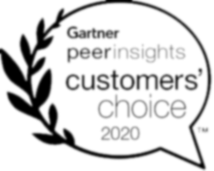

Insync^{sm}
Powered by Sophos, delivered by Lingo
Performance is all about synchronization
If your appliances and software aren’t built from the ground up to work together, synchronization between appliances won’t be perfect - lost alerts and blindspots are inherent in hybrid solutions. The security of your business requires perfection, and you get that with a 100% Sophos solution.
Insync
sm
Managed Security Solutions
Lingo Insync is a pre-packaged solution that protects all connected devices on your network from malware, phishing scams, ransomware, and botnet attacks.
Insync is built for the way you do business
Insync can be customized to the needs of each of your business locations and IT management structure. You can choose self-managed or Lingo managed solutions, and then size and deploy by location.
Sophos Market Leadership
Magic Quadrant Leader for Endpoint Protection Platforms 2022
Best managed
security offering
#1 in exploit protection
4.8/5 Rating for Exploit Detection

Slide 15

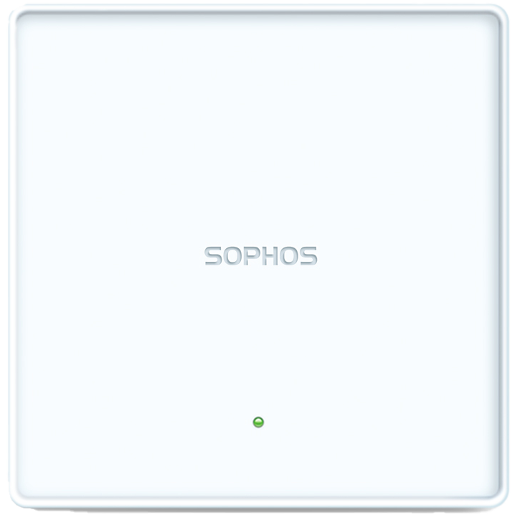


Insync^{sm}
Powered by Sophos, delivered by Lingo
One solution for complete protection across the entire attack chain.
Nextgen XGS Firewall
Wifi Access Point
Insync
Layered
Security
Intercept X
XGS 107 Firewall
APX 120 Access Point
Endpoint Protection
MDR Advanced Detection
& Response
PhishThreat Secuity
and Awareness
Email Security
(PhishThreat) Security Awareness & Testing
Central Device
Encryption
Sophos Central Portal
Config & Management
Central Email Security
Intercept-X Advanced

Slide 16
Cloud Security Powered by Zscaler
Solution Highlights
Additional Benefits
With an increase of malicious attacks targeting remote workers, a rapid deployment of a full cloud-based security stack provides for identity-based access management and visibility across all users.
Secure SD-WAN without the need to buy, deploy or manage security appliances at each location. You get the entire security stack as a cloud service, providing identical protection for each user.
Zscaler Cloud Security Platform brings the entire security stack closer to the user to ensure identical protection no matter where they connect, with fast and seamless access to the internet and cloud applications.
Can be billed monthly (OPEX vs CAPEX)
Store and analyze device data with cloud security
Enforce security policies for all remote and on-site users
Rich analytics
Easy to use web portal
Cloud security active monitoring
Scalable, secure, and proven cloud infrastructure
Simple & cost-effective implementations

Slide 17
SD-WAN Powered by VMware
Solution Highlights
Additional Benefits
Allows you to easily segment network traffic (PCI, HIPAA, employee, customer Wi-Fi) with necessary permissions for each.
Delivers optimized bandwidth usage across the entire organization with continuous network uptime. Complete and simple network visibility for proactive management and problem identification.
Trims network cost by allowing the use of more economical internet connectivity vs. the high cost of MPLS. Our technical consultants evaluate every option available to provide the best solution for your business.
Zero-touch provisioning and deployment
Business policy management for packet steering and resource allocation
Cloud based management and control
Application performance monitoring
Partner gateways designed to also protect any VoIP deployments
Works with new deployments or migrations from MPLS

Slide 18
UCaaS
Solution Highlights
Additional Benefits
Lingo UCaaS is built on a platform, featuring open APIs with a robust partner ecosystem. This allows for seamless integration and automation between business applications & communication services.
UCaaS is a cloud-based solution, making the transfer of previous PBX lines as well as all other means of communications as easy and seamlessly scalable as your business needs.
Deploying a UCaaS solution gives all users a single point of entry and unified access to all communication applications, anywhere, any time and on any device..
Online management for better visibility on all end points
Mobility to empower your workforce
Scalable for easy adapting as business changes
Best-in-class voice & video quality
Feature-rich to meet all communications needs
Data redundancy for disaster recovery
Lower costs to optimize existing resources

Slide 19
Connectivity
Solution Highlights
Additional Benefits
We design solutions uniquely suited to your business' needs and assign a dedicated Account Manager & support team who are ready to trouble shoot and correct any technical issues.
Circuit monitoring through SolarWinds gives us visibility into the health & status of all circuits that use a Static IP; catching issues before they make an impact. Adding VirtualTech gathers information & compares against aggregated data to optimize bandwidth performance.
We work with you to identify the best solution, with options ranging from DSL to Coax, to high-speed fiber connections, as well as wireless and cellular solutions. Any site; any service.
Automated monitoring & repair
Proactive trouble ticketing for circuit outages
No backhauling of important data, avoiding latency
My BullsEye Account (MBA) portal to pull inventory or request network changes

Slide 20

Forebearance and Its Impacts
Price Increases: significant price increases over time
Diminishing Service & Support: Carriers are no longer investing in their copper infrastructure or support resources, which has resulted in the decrease of maintenance and support of these lines.
Decommissioning: Some carriers are moving forward with copper line (POTS) decommissioning, and others are expected to follow. Additionally, some are simply transitioning these lines to alternate technologies behind the scenes which can end up being costly.
FCC Forbearance Order 19-72A1
Gives local exchange carriers permission to raise their rates and stop maintenance on POTS -- to encourage people to move away from traditional analog phone lines.

Slide 21
The Opportunity – Upgrade & Save
Improved Reliability & Features at a Much Lower Cost
You can replace these costly analog lines with digital services that are inherently more reliable and feature-rich.
Turnkey Managed Services
Real-time Transport & Power Failover
Federal, State & Local Compliance
All of your Voice, Fire, Life, Safety and specialty lines are now provided as a new managed service.
Real-time Back-Up Wireless Broad-band can be provided to best ensure round the clock availability of your most critical services when most needed. Real-time battery backup in the case of office electrical power outages.
SafeLine meets all the State and Federal standards, codes and certifications to provide lines for Fire Alarms, Security Alarms, Elevators, Access Control, and Fax. This includes compliance with NFPA 72 as an MFVN (Managed Facilities-based Voice Network), UL-864 (Standard for Control Units and Accessories for Fire Alarm Systems), HIPAA, PCI

Slide 22
Lingo is the Only Comprehensive Solution
POTS Rate Stability
Lingo has carrier agreements in place that insulate against future rate increases, so you can plan and deploy your POTS replacement based on your business needs and not those of the underlying carrier.
Industry-Leading FLS Services
With Lingo’s SafeLine Alert+, you get a next-generation POTS replacement solution that is more reliable, scalable, and affordable than traditional copper-based solutions, making it ideal for mission-critical applications.
Full-Featured UC Cloud Platform
All of your non-FLS voice services can be served by Lingo’s UCaaS cloud platform.

Slide 23

Safeline Alert+
FUTUREPROOF FIRE, LIFE & SAFETY
Lingo’s solution ultilizes DataRemote’s trusted hardware endpoints for reliable, managed VoIP-based analog phone lines that connect to new or existing FLS and other critical services.
What’s included
Features
Analog-to-VoIP FXS gateway with simple, transparent, per line pricing
Professional installation and connection to existing analog endpoints
Proactive monitoring and managed support 24x7x365
Elimination of costly analog wireline services
Totally managed, hassle-free service
Analog POTS line replacements
Caller-ID
E-911 Support
Integrated Battery backup
Cellular 4G/LTE backup support
CDS-9090
8 RJ-11 FXS port
1 RJ-45 WAN port
4 RJ-45 LAN port
LTE Dual SIM
Wi-Fi
SFP port
12 hr battery backup
Multiple Failover Options
DRI-9080
RJ-11 8 FXS port
1 RJ-45 WAN port
1 RJ-45 LAN port
Plug and Play
LED Lights
CDS-9070
23 RJ-11
4 LAN
1 WAN
Wi-Fi
LTE Dual SIM
ATT & T-Mobile
12 hr battery backup
Multiple Failover
Options
CDS-9010B
2 RJ-11 FXS port
1 RF-45 WAN port
2 RJ-45 LAN port
LTE Dual SIM
Wi-Fi
24 hr battery backup
Multiple Failover
Options
Equipment options

Slide 24
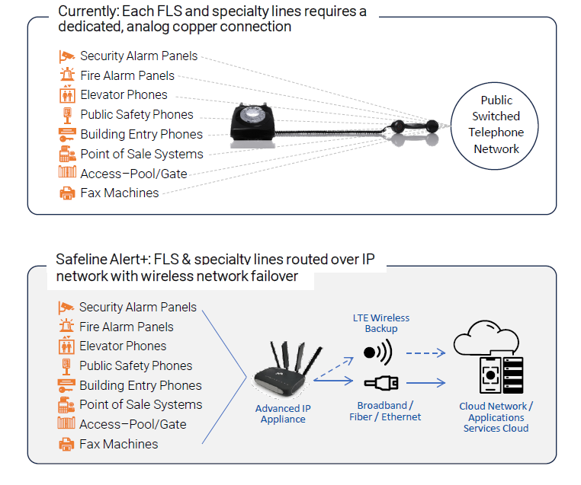
Safeline Alert+
FUTUREPROOF FIRE, LIFE & SAFETY
How Safeline Alert+ Works

Slide 25
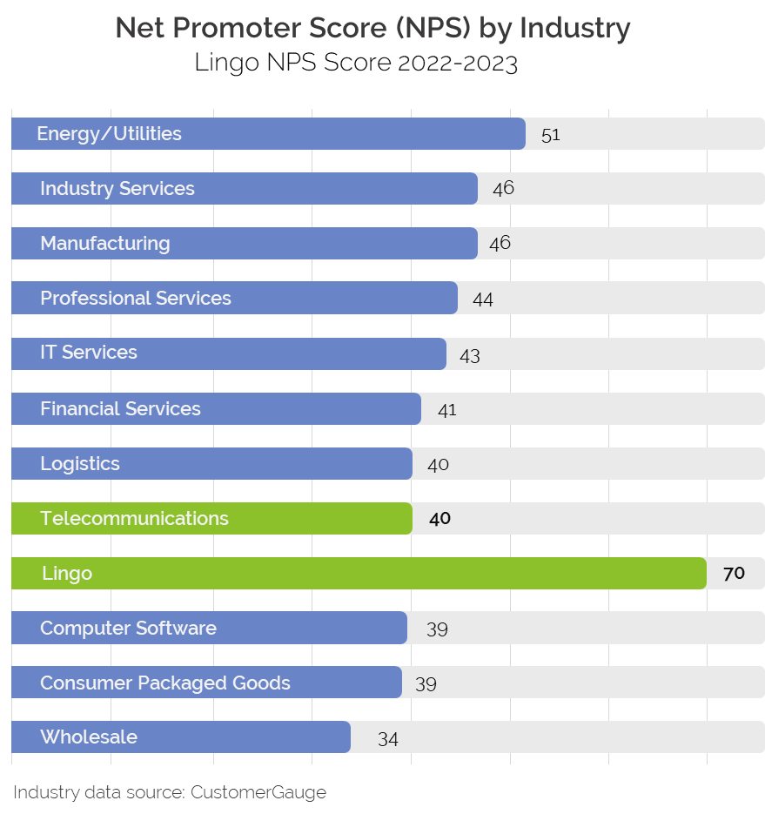
POTS Replacement at Enterprise Scale
No one does it better. With over two decades of service delivery experience, Lingo’s project management and incident response NPS score is significantly above the telecom industry average.
Lingo has the nationwide scale to deploy a fully-managed service for all of your life safety systems, for every site.
Here’s why: we’re all about continuous improvement. We measure continuously and act on feedback by improving our work processes.

Slide 26


Deployment Designed for 100% Acceptance
When you put your trust in Lingo you get a detail-focused, highly experienced, dedicated project team handling every aspect of your deployment.
Site Surveys
Nationwide, experienced team of technicians will Identify site requirements and details prior to the start of your project.
Scope of Work
Sales engineers will determine the necessary equipment and support required.
Solution Design
Sales engineers will work within your Lingo dedicated project team to develop a comprehensive design and installation plan.
Implementation Logistics Coordination
Your dedicated project manager and project team will get the right equipment and people where they need to be at the right time.
System Integrity and Ongoing Management
Your dedicated project manager will follow up to ensure you’re completely satisfied with the deployment, and coordinate handoff to your Lingo client support teams.
Project Plan Scheduling
Your dedicated project manager and project team will coordinate the deployment schedule with you and your Lingo on-site tech team.

Slide 27


Your Service Installation Experience
5. Installation
3. Site Survey
You must be present on-site
You must be present on-site
You or a designated company representative must be present on site.
Expect our installation vendor on site to perform your site survey.
You or a designated company representative must be present on site.
Expect our installation vendor on site to perform your site survey.
1. Service Conversion Plan
Call with Lingo Sales Engineer
1
Day
Define & document and documenting the requirements that are related to your business objectives.
30
Days
6. Lingo Follow-up
10-14
Days
2
Days
Post installation service assurance call
Your Lingo Project Manager will call to verify the installation was made to your satisfaction.
2
Days
4. Installation Scheduled
Email Notification or phone call from Lingo
2. Schedule Site Survey
You will receive an email or phone with your scheduled date for your site survey.
Email Notification or phone call from Lingo
You will receive an email or phone with your scheduled date for your site survey.

Slide 28
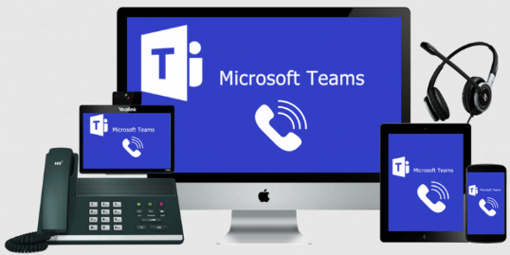
Direct Routing for MS Teams
What are the Main Advantages of Direct Routing?
Seamless calling from within MS Teams - desktop, mobile, endpoint
Advanced calling features - voice mail, forwarding, hunt groups, auto-attendant
Instant access to your contacts - uses MS Teams contact list
One-click meeting creation
Collaborate with both internal and external users at the same time

Slide 29

Technical Support as a Service - TSaaS
Are you Facing These Challenges?
Employees on-site that lack the skill set to perform this work
Budget or time to send employees to other sites
A way to contract qualified technicians in the areas where you operate
Knowledge to write a scope of work to get the work completed
Time to research local talent
Onboarding newly acquired locations
Applications for TSaaS
Wiring new buildings for Ethernet
Replacing UPS batteries
Fiber Optic Extensions
Installing Home Theater/Audio Visual
PC replacement
Printer installation
Mounting Webcams
Electrical work
Replacing automatic door
Alarm system installation
Kiosk installation
Onboarding newly acquired
locations
Point of Sale (POS) installation

Slide 30
Action Items for Follow-Up
Item | Owner | Target Date
Notes:
Need a separate slide for MACH Networks, LTE MTM Data

Slide 31
Action Items POTS Replacement
Item | Owner | Target Date
Notes:
Need a separate slide for MACH Networks, LTE MTM Data

Slide 32
Action Items for LTE MTM Data
Item | Owner | Target Date
Notes:
Need a separate slide for MACH Networks, LTE MTM Data

Slide 33
THANK YOU

Slide 34
Insync^{sm}
Powered by Sophos, delivered by Lingo
MDR Advanced Detection & Response
XGS 107 Firewall
APX 120 Access Point
Next generation protection combines security and network appliances into one. Full Intrusion Detection and Prevention Systems options built into firewall rules. Sophos Deep Learning and Zero-Day Protection detects malware based on file behavior, not a list of virus definitions.
Sophos Managed Detection and Response is a fully managed service delivered by experts who detect and respond to cyberattacks targeting your computers, servers, networks, cloud workloads, email accounts, and more.
Managed from Sophos Central portal. Able to create locations and assign access points to a map after install. Option for global settings for companies that have consistent Wi-Fi SSIDs and passwords across locations. APX series can take advantage of Sophos Heartbeat when paired with firewall and/or Intercept-X Advanced. Will alert to possible threats on your network such as rogue access points, SSID spoofing, etc. Usage reports advise on network health and inappropriate behavior. Easy deployment. Outdoor model available.
Central Email Security
Intercept-X Advanced
Email messages are securely delivered via proxy to Sophos for scanning, then returned to your intended recipient. Same for outbound. If you have ever seen a phishing email from someone you know, you know that unintentional malware is a real threat in email.
Anti-spam, anti-virus, malicious link checker, zero-day detection with Sandstorm, DLP and encryption options for email.
Advanced Endpoint Protection platform (AEP),
Workstation (laptop) and server versions
Machine learning adds expertise, not headcount.
Version with EDR (endpoint detection and response) adds forensic investigation to determine if an attack was successful and how far it went. For example, being able to identify a malicious browser extension in addition to removing the threat.
PhishThreat Secuity
and Awareness
Simulated attack campaigns and training in 3 easy steps: (1) TEST - customizable attack templates fed by latest threat intelligence; (2) TRAIN - range of interactive training courses covering security and compliance topics; (3) MEASURE - campaign reporting and security posture by organization, group or individual.
Central Device Encryption
Secure Devices and Data with full disk encryption for Windows and macOS. It’s intuitive, easy to setup, easy to manage. Start securing devices in minutes. Document compliance – Verify device encryption status and demonstrate compliance.
Sophos Central Portal Configuration & Management
Manage all Sophos products from a single interface.
Intuitive site navigation. Cloud reports combined from multiple products. Alerts for all products on one dashboard, organized by time or priority. Usage summary of active/inactive devices

Slide 35


Recent Acquisition
On August 16, 2022, Lingo Management, LLC completed its acquisition of BullsEye.
This transaction creates a communications and technology services powerhouse to comprehensively meet the evolving long-term needs of our clients.
Things you should know:
There will be absolutely no disruption or change in service for all of our clients.
Clients can still reach us on the same contact numbers and access the same portals as they always have.
Our portfolio of services will be GROWING – stay tuned for more information.
Here’s a link to the official release:
https://www.lingo.com/2022/03/29/lingo-management-to-acquire-bullseye-telecom/
Learn more about Lingo: www.lingo.com
Notes:
DONE Update needed; Acquisition completed on August 16, 2022

Slide 36


Paperless Invoicing
In an effort to reduce waste and be ecologically responsible, Lingo has implemented a monthly fee of $8.95 for mailing paper invoices.
Avoid the fee and GO GREEN by signing up for online invoicing!
Invoices at your fingertips - retrieve your invoices online each month within your My BullsEye Account (MBA) Portal.
Get notified - sign up to receive notifications as soon as your invoices are available.
Additional charges apply for 50 or more locations.
GO GREEN.
GO PAPERLESS!
Notes:
Pricing outdated; Not $3.99….. $8.95

Slide 37
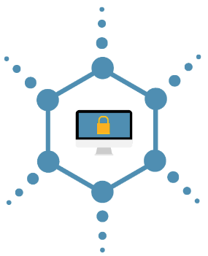
Lingo Penetration Testing
Penetration Testing
  An authorized simulated cyberattack on a computer system
  Performed to evaluate the security of the system
  Security issues that the penetration test uncovers are reported through a penetration test report
    Provides an assessment of potential impacts to the organization.
    Suggest counter measures to reduce risk.

Slide 38
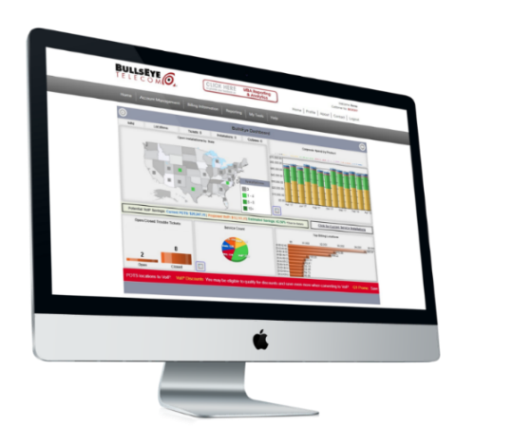

Intuitive Online Account Interface
Easy-to-Use Online Portal
My BullsEye Account (MBA) is the gateway to ALL of the information our clients and partners require to manage their communications & technology.
With MBA, you have access to:
New and historical invoices for paperless billing.
Comprehensive telecom management tools.
Online ticketing & support resolution.
Single sign-in for managing associated accounts.
Insight into operational performance on an individual location level; enabling immediate, tactical adjustments.
Check out your MBA!

