Slide 1
<<Name of the Company>>
<<DATE>>
<<CRM Name>>
<<AM Name>>
<<SE Name>>
Quarterly Business Review

Slide 2
Active Services
New locations or services in next three months?
Any relocated locations in next three months?
Does Lingo manage all locations?
Any RFPs coming out in the next three months?

Slide 3
Deactivated Services
Closing any locations in next three months?
Disconnection of services in next three months?
Any services moving to an alternate provider?

Slide 4
Robust Solution Portfolio
POTS
POTS Replacement
Direct Routing
for MS Teams
UCaaS
Trunking
TSaaS
Virtual Tech
The Best Solutions from
the Best Providers
Communications
Tech Services
Security
Connectivity
Managed Security
Protect all connected devices on your network from malware, phishing scams, ransomware, and botnet attacks
Zscaler
Internet
Wireless
SD-WAN
Notes:
Ask questions

Slide 5
Action Items for Follow-Up
Item | Owner | Target Date
Notes:
Need a separate slide for MACH Networks, LTE MTM Data

Slide 6
THANK YOU

Slide 7
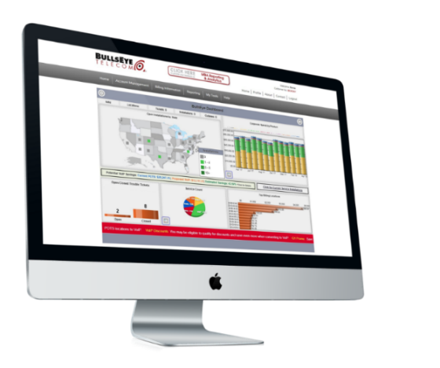
Intuitive Online Account Interface
Easy-to-Use Online Portal
My BullsEye Account (MBA) is the gateway to ALL of the information our clients and partners require to manage their communications & technology.
With MBA, you have access to:
New and historical invoices for paperless billing.
Comprehensive telecom management tools.
Online ticketing & support resolution.
Single sign-in for managing associated accounts.
Insight into operational performance on an individual location level; enabling immediate, tactical adjustments.
Check out your MBA!

