Slide 1
Partner Product Guide
James McHale
02/01/2023

Slide 2





























Products At-a-Glance
Quick Quote Tool:
https://www.mybullseyeaccount.com/new-quote-public
Partner Portal Login:
https://www.mybullseyeaccount.com/login
Quote Desk:
Salessupport@bullseyetelecom.com
VOICE
VoIP
COLLABORATION
POTS ALTERNATIVE
MISC SERVICES
CONNECTIVITY
SECURITY
Lingo - BullsEye’s Odds & Ends

Slide 3

POTS Lines & Aggregation
What is POTS?
Plain Old Telephone Service (POTS), or plain ordinary telephone service, is a retronym for voice-grade telephone service employing analog signal transmission over copper loops.
Can offer POTS lines in most markets across the US
Bring any and all POTS lines over to BullsEye
Remember BullsEye’s P2V
Check for availability…less & less true POTs (Copper) options. Should be looking at migrating to VoIP options, such as hosted voice, integrated voice, or POTs-in-a-Box replacement (EPIK)
Back2Menu

Slide 4
CONNECTIVITY
Back2Menu

Slide 5



















Bandwidth Aggregation
BullsEye has partnerships with over 150 underlying providers. Enabling best options for delivering the needed bandwidth at locations all over the United States.
T1
Fiber Optic lines
EOC
DSL
Cable
Fios
AT&T U-Verse
Microwave (WISPs)
LTE - all Carriers
Satellite
Powered by Partners like:
Back2Menu

Slide 6

BullsEye – Cellular Options
Powered by Partners:
Options:
LTE Options
5G Options
Pooled Plans
Pay per MB Plans
Modems
Routers
BYOD
Back2Menu

Slide 7

What is SD-WAN?
Powered by
SD-WAN is an acronym for Software-Defined Networking in a Wide Area Network. SD-WAN simplifies the management and operation of a WAN by decoupling the networking hardware from its control mechanism.
Reasons to utilize SD-WAN:
MPLS Replacement
Bandwidth Aggregation
Network Enhancement
HIPAA & PCI Compliance
Auto Failover & failback
Application Control
Back2Menu

Slide 8

Right-size Your Edge
Powered by
 |  | VCE | TUNNEL SIZE OPTIONS
Max Throughput | Max Tunnels | Edge/BW | 10 M | 30 M | 50 M | 100 M | 200 M | 350 M | 500 M | 750 M | 1 G | 2 G | 5 G | 10 G
100 Mbps | 25 | Edge 510 | * | * | * | * | *
100 Mbps | 25 | Edge 510-LTE | * | * | * | * | *
100 Mbps | 50 | Edge 520 | * | * | * | * | *
200 Mbps | 50 | Edge 520v | * | * | * | *
500 Mbps | 100 | Edge 540 |  |  |  | * | * | * | * | * | *
200 Mbps | 50 | Edge 610 | * | * | * | * | * | *
750 Mbps | 100 | Edge 620 |  |  |  | * | * | * | * | * | *
1 Gbps | 400 | Edge 640 |  |  |  | * | * | * | * | * | * | *
2 Gbps | 800 | Edge 680 |  |  |  | * | * | * | * | * | * | * | *
1.5 Gbps | 400 | Edge 840 |  |  |  | * | * | * | * | * | * | *
5 Gbps | 6000 | Edge 2000 |  |  |  |  |  |  | * | * | * | * | * | *
2.5 Gbps | 4000 | Edge 3400 |  |  |  |  | * | * | * | * | * | * | *
5 Gbps | 6000 | Edge 3800 |  |  |  |  |  |  | * | * | * | * | * | *
Back2Menu

Slide 9
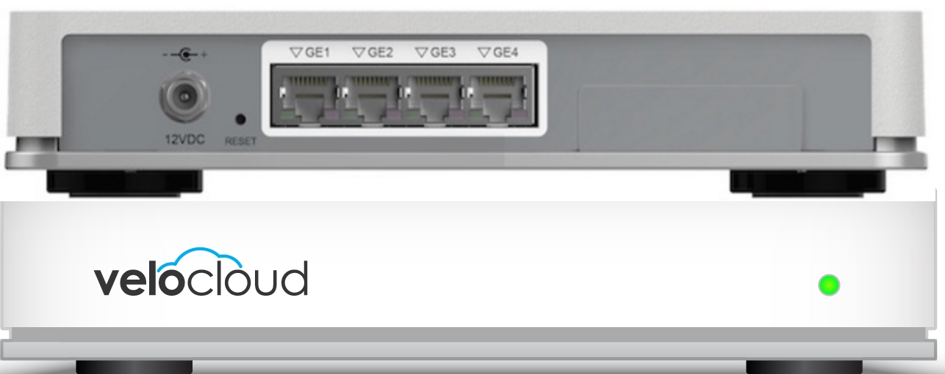
VCE-510 & VCE-510-LTE
Powered by
SD-WAN Edge
(4) LAN / WAN Assignable RJ-45 ports
(2) USB 3.0 ports
Integrated Wi-Fi
100 Mbps Max Throughput
Back2Menu

Slide 10
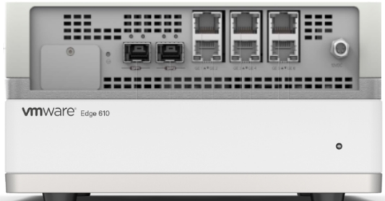
VCE-610
Powered by
SD-WAN Edge
(6) LAN / WAN Gigabit RJ-45 ports
(2) SPF WAN Ports
(2) USB 3.0 ports
Integrated Wi-Fi
350 Mbps Max Throughput
Back2Menu

Slide 11
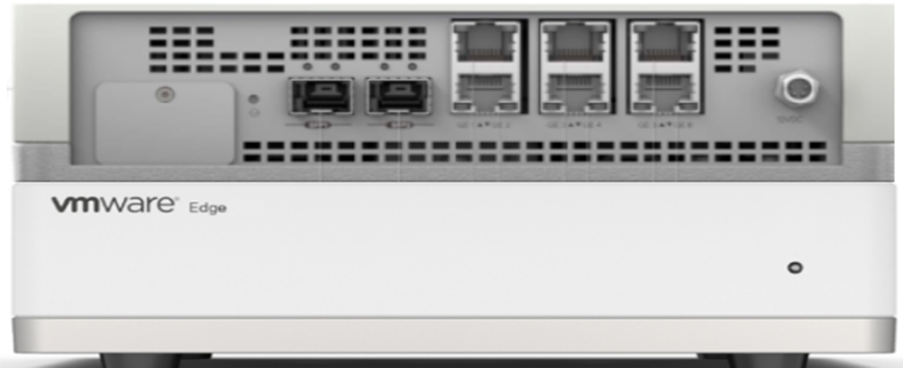
VCE-620
Powered by
SD-WAN Edge
(6) LAN / WAN Gigabit RJ-45 ports
(2) SPF WAN Ports (supports SFP+ 1/10Ge modules)
(2) USB 3.0 ports
Integrated Wi-Fi
750 Mbps Max Throughput
Back2Menu

Slide 12
VCE-640
Powered by
SD-WAN Edge
(6) LAN / WAN Gigabit RJ-45 ports
(2) LAN / WAN 1G/10G SFP+ ports
(2) USB 3.0 ports
Integrated Wi-Fi
1 Gbps Max Throughput
Back2Menu

Slide 13
VCE-680
Powered by
SD-WAN Edge
(6) LAN / WAN Gigabit RJ-45 ports
(2) LAN / WAN 1G/10G SFP+ ports
(2) USB 3.0 ports
Integrated Wi-Fi
2 Gbps Max Throughput
Back2Menu

Slide 14
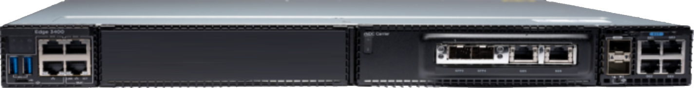
VCE-3400
Powered by
SD-WAN Edge
(6) LAN / WAN Gigabit RJ-45 ports
(2) LAN / WAN 1G/10G SFP+ ports
(2) USB 3.0 ports
2.5 Gbps Max Throughput
Back2Menu

Slide 15
VCE-3800
Powered by
SD-WAN Edge
(6) LAN / WAN Gigabit RJ-45 ports
(2) LAN / WAN 1G/10G SFP+ ports
(2) USB 3.0 ports
5 Gbps Max Throughput
Back2Menu

Slide 16

Our wireless failover solution supports your voice communications and any mission-critical applications that are dependent on Internet connectivity with a cost effective & affordable data plan.
Solution Highlights:
Cross carrier pooling provides the best service available regardless of location
A wireless data plan is easily deployed and managed via the cloud for easy integration with your existing systems.
Avoid expensive cabling costs for seasonal or rapid deployment of Internet connectivity when using wireless as your primary data source
Be anywhere your customers are by easily deploying pop-up retail/store-in-a-store/kiosks
Power your digital signage and make frequent updates on your specials
Back2Menu

Slide 17
SECURITY SOLUTIONS
Back2Menu

Slide 18
What is a Managed Firewall?
In computing, a firewall is a network security system that monitors, and controls incoming and outgoing network traffic based on predetermined security rules. A firewall typically establishes a barrier between a trusted network and an untrusted network, such as the Internet.
With BullsEye’s Managed Firewall option, we can manage one our onsite or cloud-based firewall options for you. All of BullsEye’s Firewalls options can be self-managed via their appropriate cloud portals.
Reasons to utilize a Managed Firewall:
Have limited staff
Don’t have time to keep up on product upgrades & changes
Rather have product Subject Matter Expert handle for me
Back2Menu

Slide 19


Firewall & Security Options
PENTRATION TESTING
PHISH THREAT EDUCATION
Back2Menu

Slide 20
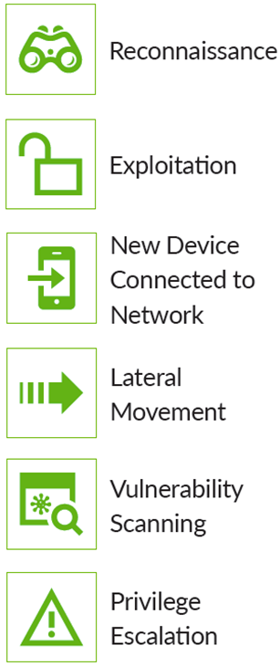
BullsEye Penetration Testing
Sample Attack Vectors
Traditional penetration testing doesn’t provide the value and insight required. The days of just “breaking in” to the environment are over. Organizations need to leverage an approach that does a better job of evaluating the effectiveness of the security controls during a real-world attack.
Not Your Traditional Penetration Testing
CBI’s Red Team services go beyond the conventional exploitation tactics used by traditional firms. Our approach is to develop engagement-specific attack scenarios that leverage automated and manual techniques. In plain English, our services are not an off-the-shelf, one-size fits all program.
Attack Detection Rankings
CBI’s Red Team evaluates the organization’s ability to identify and/or prevent attacks and malicious activities through the penetration testing. This testing emulates realistic attack chains and provides the organization with key improvement opportunities for detection and awareness.
Back2Menu

Slide 21
What is a Next Generation Firewall?
A next-generation firewall is a part of the third generation of firewall technology, combining a traditional firewall with other network device filtering functions, such as an application firewall using in-line deep packet inspection, an intrusion prevention system.
Reasons to utilize a NexGen Firewall :
Network Security
Site-to-site VPN
Client VPN
HIPAA & PCI Compliance
Auto Failover & failback
Better Data Control
Back2Menu

Slide 22

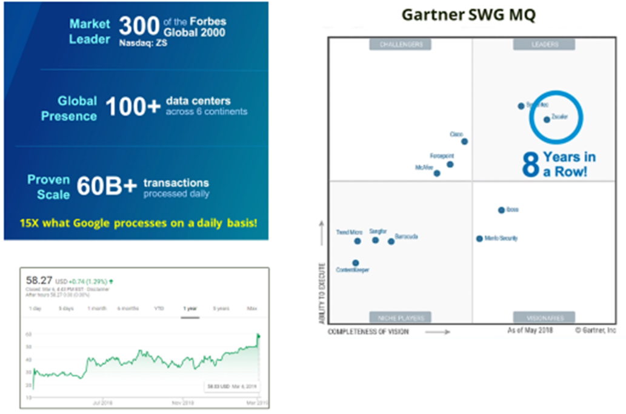
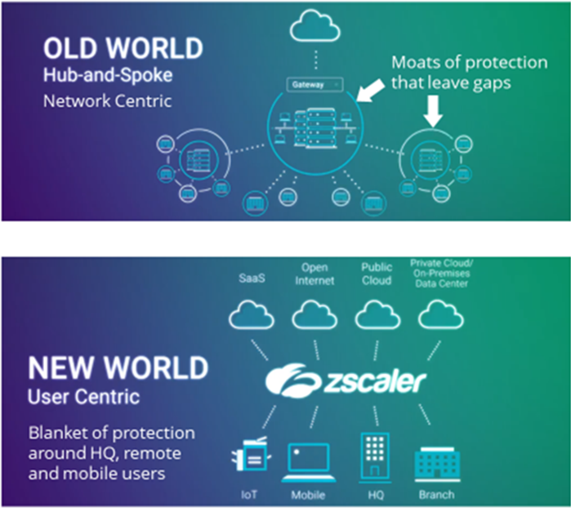
Powered by
Back2Menu

Slide 23
Cloud Security Plan Pricing
Cloud Security Platform Features | Secure Internet Platform (25 User Minimum) | ZIA Professional Bundle (10 Seat Minimum) | ZIA Business Bundle (10 Seat Minimum) | ZIA Secure Transformation Bundle (10 Seat Minimum)
High Availability Data Center Access w/latency SLAs | √ | √ | √ | √
Security Policy Follows the User Anywhere | √ | √ | √ | √
Traffic Forwarding - GRE, PAC, Proxy Chaining, IPSEC | √ | √ | √ | √
Authentication - SAML, Secure LDAP, Kerberos | √ | √ | √ | √
ZScaler Application for Mobile Traffic | √ | √ | √ | √
Real-Time Reporting and Logging: 6 Months & Real Time Reporting | √ | √ | √ | √
NSS Log (Nanolog) Streaming Service | Add-On | Add-On | √ | √
NSS Log Recovery Web Mgmt Fee | Add-On | Add-On | Add-On | Add-On
NSS Log Recovery Firewall Mgmt Fee | Add-On | Add-On | Add-On | Add-On
SSL Inspection | Add-On | Add-On | √ | √
Cloud Security Services
Content Filtering | √ | √ | √ | √
Standard Cloud Firewall: Rules by Location, IP, Ports & Protocols | √ | √ | √ | √
Advanced Cloud Firewall & Logging | Add-On | Add-On | Add-On | √
Inline Anti-Virus & Anti-Spyware | Not Available | √ | √ | √
Advanced Threat Protection | Not Available | Add-On | √ | √
Cloud Apps Control: Discover, Monitor & Control of Web Applications | Add-On | Add-On | √ | √
Web Access Control | Add-On | Add-On | √ | √
Bandwidth Control: Protect Key Apps & Limit Recreation Apps Policies | Add-On | Add-On | √ | √
Mobile Applications & Devices: Granular Policy Setting & Reporting | Not Available | Not Available | √ | √
Standard Cloud Sandbox: .exe and .dll from unknown & suspicious sites | Not Available | √ | √ | √
Advanced Cloud Sandbox: all file types, Quarantine Policy, Reports | Not Available | Add-On | Add-On | √
IPSec Encrypted VPNs | Not Available | Not Available | Not Available | Add-On
Basic DLP: True File Type Control by Users, Groups & Destinations | √ | √ | √ | √
DLP Enhanced, ICAP for DLP, DLP Exact Data Match Daily Prioritization for Top 100 Domains, Dedicated Proxy Port on Entire Cloud | Add-On | Add-On | Add-On | Add-On
Powered by
Back2Menu

Slide 24
Plan Pricing
Powered by
 | Monthly Per User Pricing
Product Name | Up to 99 | 100+ | 500+ | 1,000+ | 2,500+ | 5,000+ | 10,000+ | 25,000+ | 50,000+ | 100,000+
Secure Internet Platform | $1.80 | $1.13 | $0.81 | $0.75 | $0.68 | $0.63 | $0.57 | $0.53 | $0.51 | $0.45
ZIA Professional Bundle | $5.04 | $3.31 | $2.50 | $2.10 | $1.91 | $1.75 | $1.60 | $1.47 | $1.37 | $1.27
ZIA Business Bundle | $8.08 | $5.30 | $4.00 | $3.37 | $3.06 | $2.80 | $2.56 | $2.36 | $2.20 | $2.04
ZIA Secure Transformation Bundle | $14.83 | $9.73 | $7.34 | $6.18 | $5.62 | $5.14 | $4.70 | $4.33 | $4.04 | $3.75
ZIA Enterprise License Agreement | Minimum 10,000 seats |  |  |  |  |  | $7.68 | $6.11 | $5.37 | $4.83
Back2Menu

Slide 25
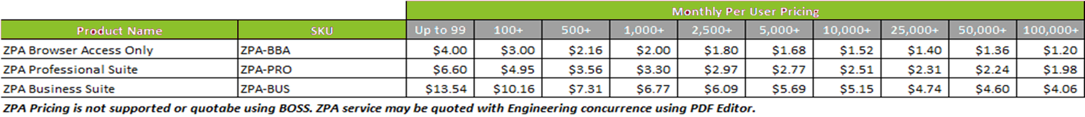
Remote Access
Powered by
Zscaler Private Access (ZPA) is a cloud service from Zscaler that provides zero trust, secure remote access to internal applications running on cloud or data center. With ZPA, applications are never exposed to the internet, making them completely invisible to unauthorized users. The service enables the applications to connect to users via inside-out connectivity versus extending the network to them.
ZPA’s unique design is based on four key tenets:
Connect users to applications without placing users on the network
Never expose applications to unauthorized users
Enable app segmentation without network segmentation
The internet is the new corporate network
Back2Menu

Slide 26
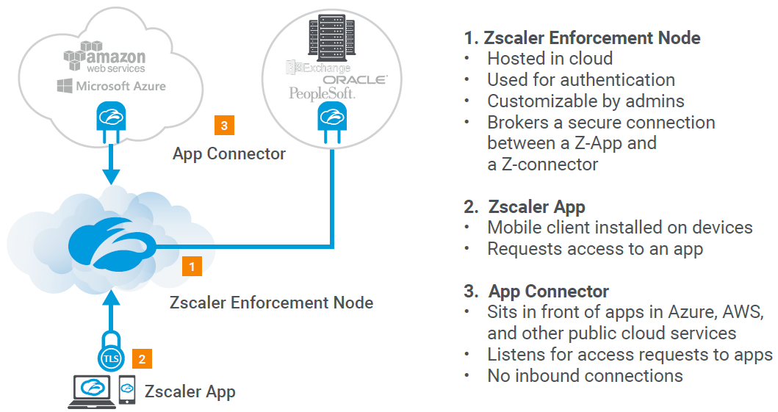
Remote Access
Powered by
Back2Menu

Slide 27
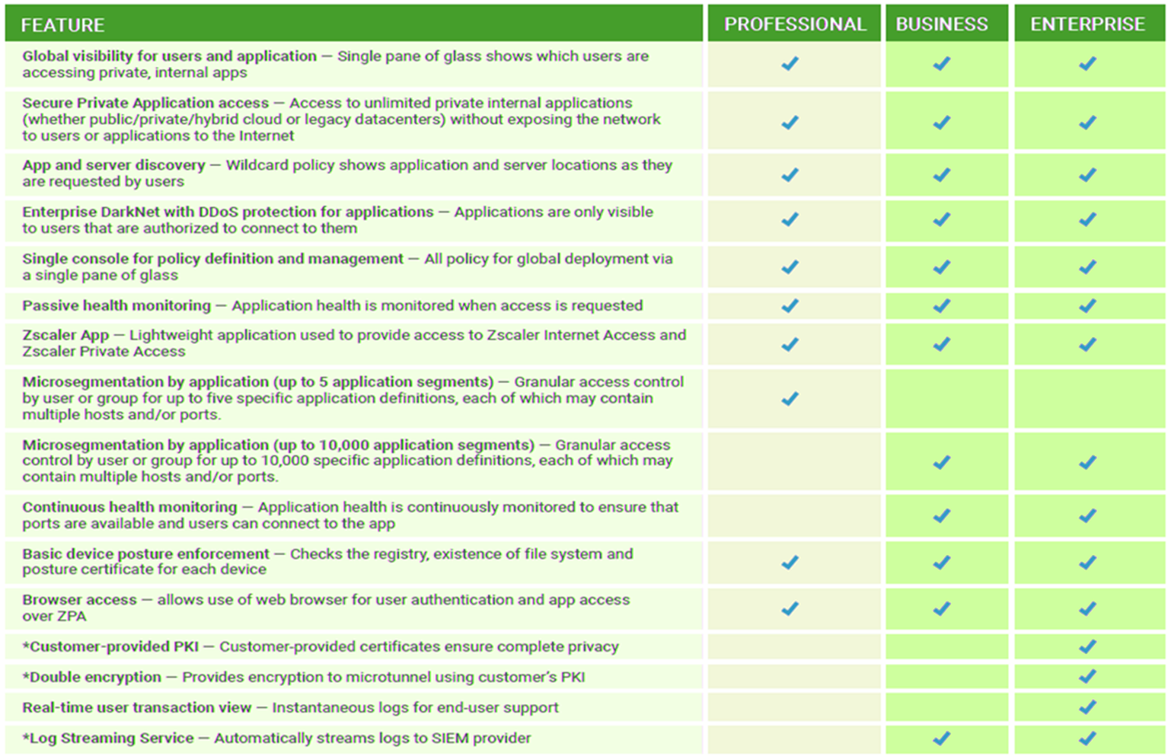
Back2Menu

Slide 28

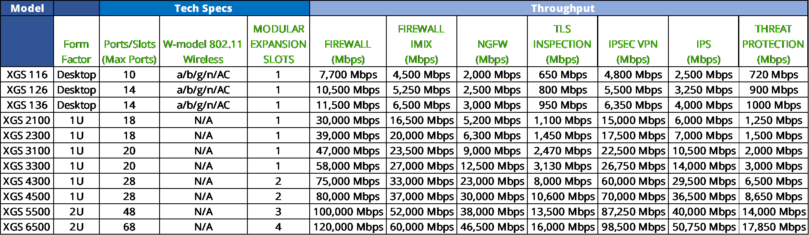
Powered by
Back2Menu

Slide 29
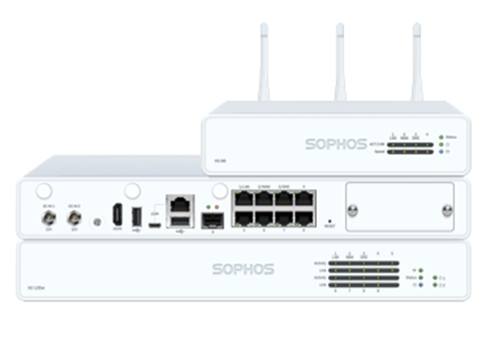
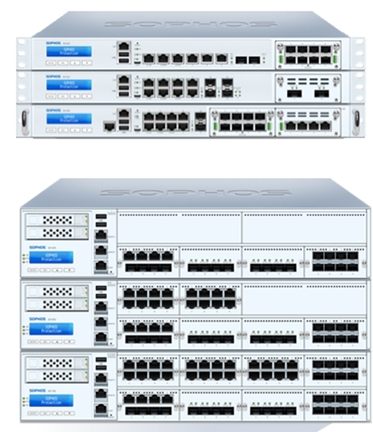

Powered by
XGS 2100
XGS 2300
XGS 3100
Desktop Models
XGS 116
XGS 126
XGS 136
XGS 3300
XGS 4300
XGS 4500
XGS 5500
XGS 6500
Back2Menu

Slide 30
Endpoint Protection
Powered by
BullsEye’s endpoint protection software from Sophos delivers total defense from today’s onslaught of viruses and malware for every device type imaginable. Intercept X from Sophos provides endpoint protection against today’s threats, and Sophos designed it from the ground up using 30+ years of virus and malware detection experience.
Here’s how it works:
Get advanced protection to stop the latest threats
Make management straightforward
Spend less and save time
Implement security that grows with you
Benefit from smarter, faster protection
Stop unknown threats such as Zero-day viruses and malware
Block ransomware beyond just blocking with rollback capabilities
Deny attackers
Back2Menu

Slide 31
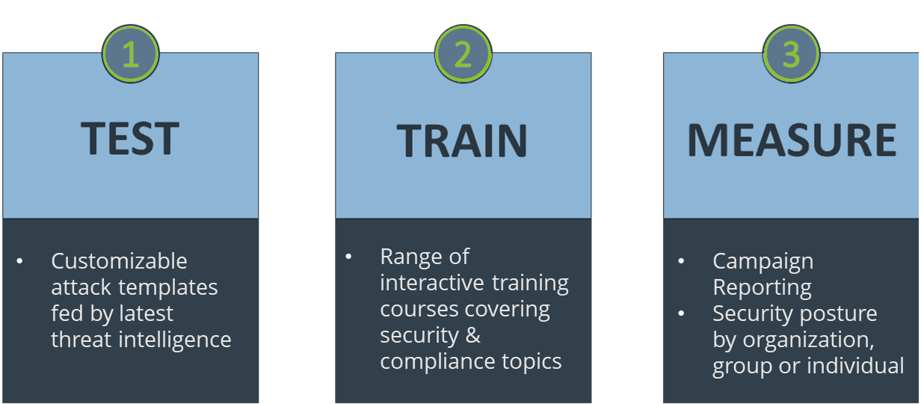
Phish Threat Education
Powered by
Multiple scenarios & difficulties
Choice of 9 languages
Realistic simulations powered by global threat intelligence
Library of international templates from beginner to expert
Simulated attack campaigns and training in 3 easy steps.
Security Topics
Phishing
Credential harvesting
Vishing (phone phishing)
Social engineering
Ransomware
Secure social media use
Public Wi-Fi
Malicious attachments
Passwords & passphrases
Customizable attack templates fed by latest threat intelligence
Range of interactive training courses covering security & compliance topics
Campaign Reporting
Security posture by organization, group or individual
Back2Menu

Slide 32






MANAGED - BullsEye Router & Switch
VIRTUAL TECH
MANAGED ROUTER
MANAGED SWITCH
MANAGED FIREWALL
MANAGED WI-FI
Remote management of onsite infrastructure hardware.
Back2Menu

Slide 33
What is a Virtual Tech?
A Virtual Tech is a BullsEye networking device that allows our Support Engineers to securely remote access your network to do testing on your computer networks current issue and help get it resolved much faster than waiting for a Tech to be deployed onsite.
Reasons to utilize a Virtual Tech:
Customer has a lot of locations that want to deploy any of BullsEye’s many VoIP options and need assistance in running BullsEye’s VoiceReadinessTesing and remediate the issues with the under-lying broadband carrier.
Back2Menu

Slide 34
What is a Managed Router?
A Router is a networking device that forwards data packets between computer networks. Routers perform the traffic directing functions on the Internet. Data sent through the internet, such as a web page or email, is in the form of data packets.
Reasons to utilize a Managed Router:
Customer wants / needs a managed Edge Device but already has a firewall. This can be added to any broadband connection.
Back2Menu

Slide 35

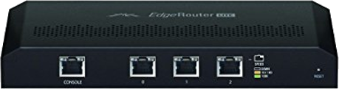
ERLite-3
Powered by
Managed Router
(3) LAN / WAN Gigabit RJ-45 ports
Back2Menu

Slide 36
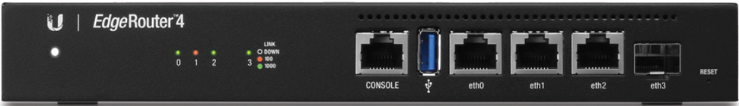
ER-4
Powered by
Managed Router
(3) LAN / WAN Gigabit RJ-45 ports
(1) SFP WAN/LAN assignable port
Back2Menu

Slide 37

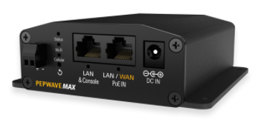
MAX-BR1-MINI-LTE-US-T-M
Powered by
Managed Router
Industrial-Grade 4G LTE Router
1x Embedded 4G LTE Modem (for use in the US)
1x Optional Ethernet WAN
Optional WAN Failover
no Wi-Fi no GPS
Back2Menu

Slide 38
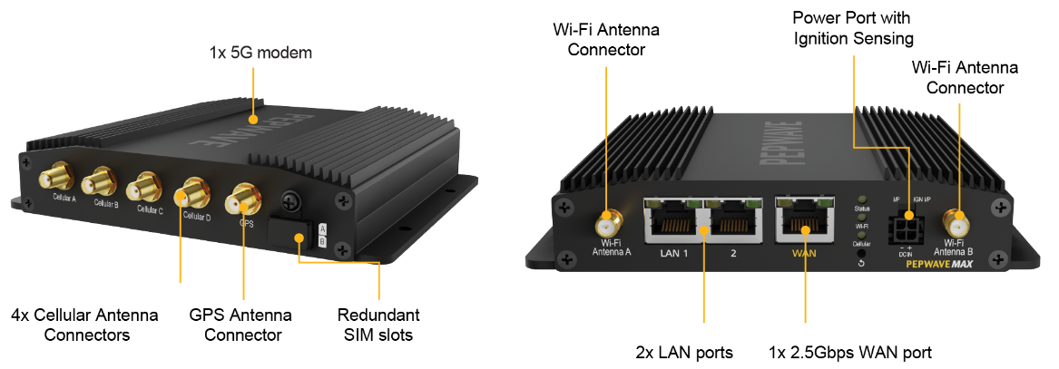
Powered by
MAX-BR1-PRO-5G-T-PRM
Managed Router
Internet Connections Supported: 1 Embedded 5G/Cat 20 LTE, 1 Wired WAN, Wi-Fi as WAN*
Networks Supported for Embedded Modem: 5G (NSA) Sub 6Ghz: n1, n2, n3, n5, n28, n41, n66, n71, n77, n78, n79; 4G bands: B1, B2, B3, B4, B5, B7, B8, B12, B13, B14, B17, B18, B19, B20, B25, B26, B28, B29, B30, B32, B34, B38, B39, B40, B41, B42, B46, B48, B66, B71
Certifications: AT&T, FirstNet, T-Mobile, Us Cellular, Verizon, and Verizon CBAND
Wi-Fi Standard: Wi-Fi 6, 2X2 MU-MIMO
Wi-Fi Range: 250-300' through walls, much greater unobstructed (variable depending on interference from other electronics and physical interference such as walls and ceilings)
Ethernet ports: 2 GbE LAN + 1 GbE WAN
The BR1 Pro 5G uses a 4FF Nano SIM (not 2FF like many other routers)
Back2Menu

Slide 39
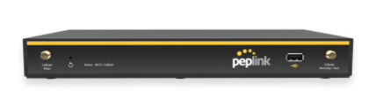
Powered by
BPL-021X-LTE-US-T-PRM
Managed Router
Futureproof SD-WAN Router for Small Businesses and Branches
1x GE WAN ports
4x GE LAN ports
1x LTE modem (CAT-4)
900Mbps Router Throughput
Back2Menu

Slide 40

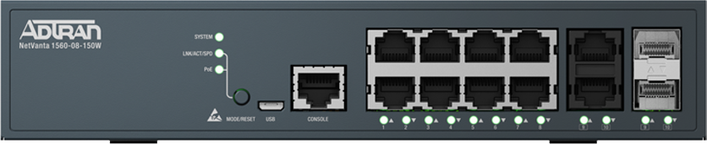
NetVanta 1560-08-65W
Managed Router
The NetVanta 1560 Series of enterprise-class, fully managed Gigabit PoE+ switches are the best switches for supporting highly resilient IoT, cloud applications, and Voice over IP (VoIP).
They are purpose built for enterprises looking to upgrade their networks with high-performance, reliable, scalable and easy-to-manage switching solutions.
NetVanta 1560 switches offer advanced multilayer switching, high-bandwidth capabilities, voice-aware features, and the right functionality to enable scaling from small business to enterprise-sized networks.
12-Port
L3
10 x 10/100/1000 (PoE+) + 2 x Gigabit SFP
rack-mountable
PoE+ (150 W)
Back2Menu

Slide 41

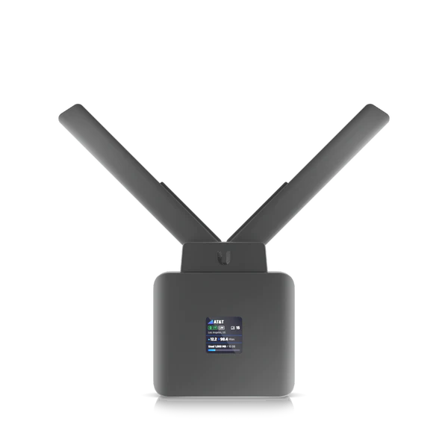
UniFi Mobile Router
Managed Router
Plug-and-play managed mobile Wi-Fi router.
LTE Category 4
USB-C, Terminal block, and PoE power options
(1) GbE PoE LAN port for second device*
Integrated GPS
Detachable long-range antenna
Prerequisite
Requires Unifi Dream Machine
TSaaS only offering
Back2Menu

Slide 42
Dream Machine Pro
Managed Router
All-in-one, enterprise-grade UniFi OS Console and security gateway designed to host the full UniFi application suite. These enable control of Wi-Fi, Security Cameras, Phone Systems, and Door Access.
Pre-installed UniFi Network application
LAN ports: (8) GbE RJ45, (1) 10G SFP+
WAN ports: (1) GbE RJ45, (1) 10G SFP+
Threat management and traffic/client identification
(1) 3.5" HDD bay for storing UniFi Protect recordings
Prerequisite
Requires Unifi Dream Machine
TSaaS only offering
Back2Menu

Slide 43
Dream Machine Pro SE
Managed Router
All-in-one, enterprise-grade UniFi OS Console and security gateway designed to host the full UniFi application suite. These enable control of Wi-Fi, Security Cameras, Phone Systems, and Door Access.
Integrated 8-port PoE Switch
128 GB of integrated storage
LAN ports: (8) GbE RJ45, (1) 10G SFP+
WAN ports: (1) 2.5GbE RJ45, (1) 10G SFP+
Threat management and traffic/client identification
(1) 3.5" HDD bay for storing UniFi Protect recordings
Prerequisite
Requires Unifi Dream Machine
TSaaS only offering
Back2Menu

Slide 44
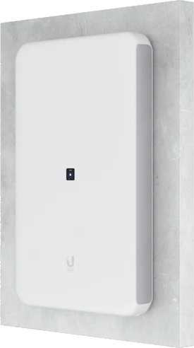
Dream Wall
Managed Router
Wall-mountable UniFi OS Console with a built-in security gateway, high-speed access point, network video recorder, and PoE switch. This console can host the full UniFi application suite and connect to multiple redundant power supplies.
Dual-band (2.4GHz and 5GHz) WiFi AP with a 2.7 Gbps aggregate throughput rate
WAN ports: (1) 10G SFP+ and (1) 2.5GbE RJ45
LAN ports: (1) 10G SFP+ and (17) GbE RJ45 LAN ports, including (4) PoE, (4) PoE+, and (4) PoE++ outputs
128 GB of integrated storage and an additional Micro SD card slot (Additional memory cards must contain at least 128 GB of storage)
Prerequisite
Requires Unifi Dream Machine
TSaaS only offering
Back2Menu

Slide 45
What is a Managed Switch?
A network switch is networking hardware that connects devices on a computer network by using packet switching to receive and forward data to the destination device. A network switch is a multiport network bridge that uses MAC addresses to forward data at the data link layer of the OSI model.
Reasons to utilize a Managed Switch:
PoE+ Power for Access Points & IP Phones
Traffic Shaping (Voice)
Additional ports needed
VLAN Segmentation
Back2Menu

Slide 46
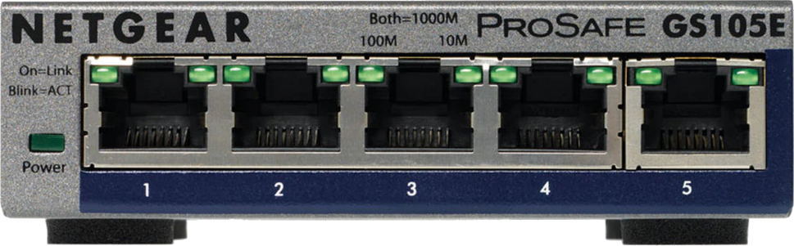
GS728TP-200NAS SWITCH
Powered by
Managed Switch
(5) Gigabit Port
Current edge traffic shaping switch
Back2Menu

Slide 47
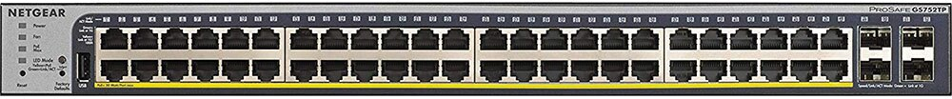
GS728TP-200NAS SWITCH
Powered by
Managed PoE+ Switch
(16) Gigabit RJ-45 ports
(4) Gigabit SFP ports
Back2Menu

Slide 48
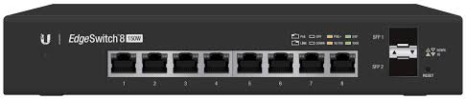
PoE+ ES-8-150W SWITCH
Powered by
Managed PoE+ Switch
(8) Gigabit RJ-45 ports
(2) Gigabit SFP ports
Back2Menu

Slide 49
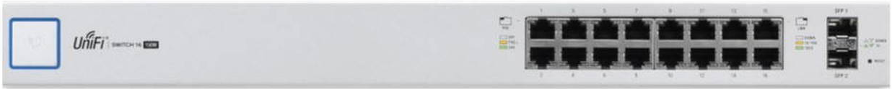
PoE+ ES-16-150W SWITCH
Powered by
Managed PoE+ Switch
(16) Gigabit RJ-45 ports
(2) Gigabit SFP ports
Prerequisite
Requires Unifi Dream Machine
TSaaS only offering
Back2Menu

Slide 50
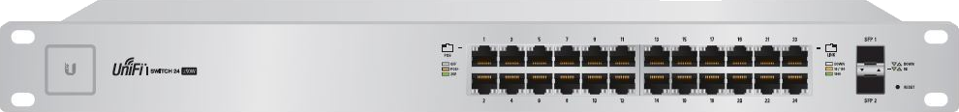
PoE+ ES-24-250W SWITCH
Powered by
Managed PoE+ Switch
(24) Gigabit RJ-45 ports
(2) Gigabit SFP ports
Prerequisite
Requires Unifi Dream Machine
TSaaS only offering
Back2Menu

Slide 51

PoE+ ES-48-500W SWITCH
Powered by
Managed PoE+ Switch
(48) Gigabit RJ-45 ports
(2) Gigabit SFP ports
(2) 10 Gigabit SFP Ports
Prerequisite
Requires Unifi Dream Machine
TSaaS only offering
Back2Menu

Slide 52
What is a Managed W-Fi?
A Wi-Fi network is simply an internet connection that’s shared with multiple devices in a home or business via a wireless router. The router is connected directly to your internet modem and acts as a hub to broadcast the internet signal to all your Wi-Fi enabled devices. This gives you flexibility to stay connected to the internet as long as you’re within your network coverage area.
Reasons to utilize a Managed Wi-Fi:
Have limited staff
Don’t have time to keep up on product upgrades & changes
Rather have product Subject Matter Expert handle for me
Back2Menu

Slide 53





WIFI POWER OPTIONS
Back2Menu

Slide 54
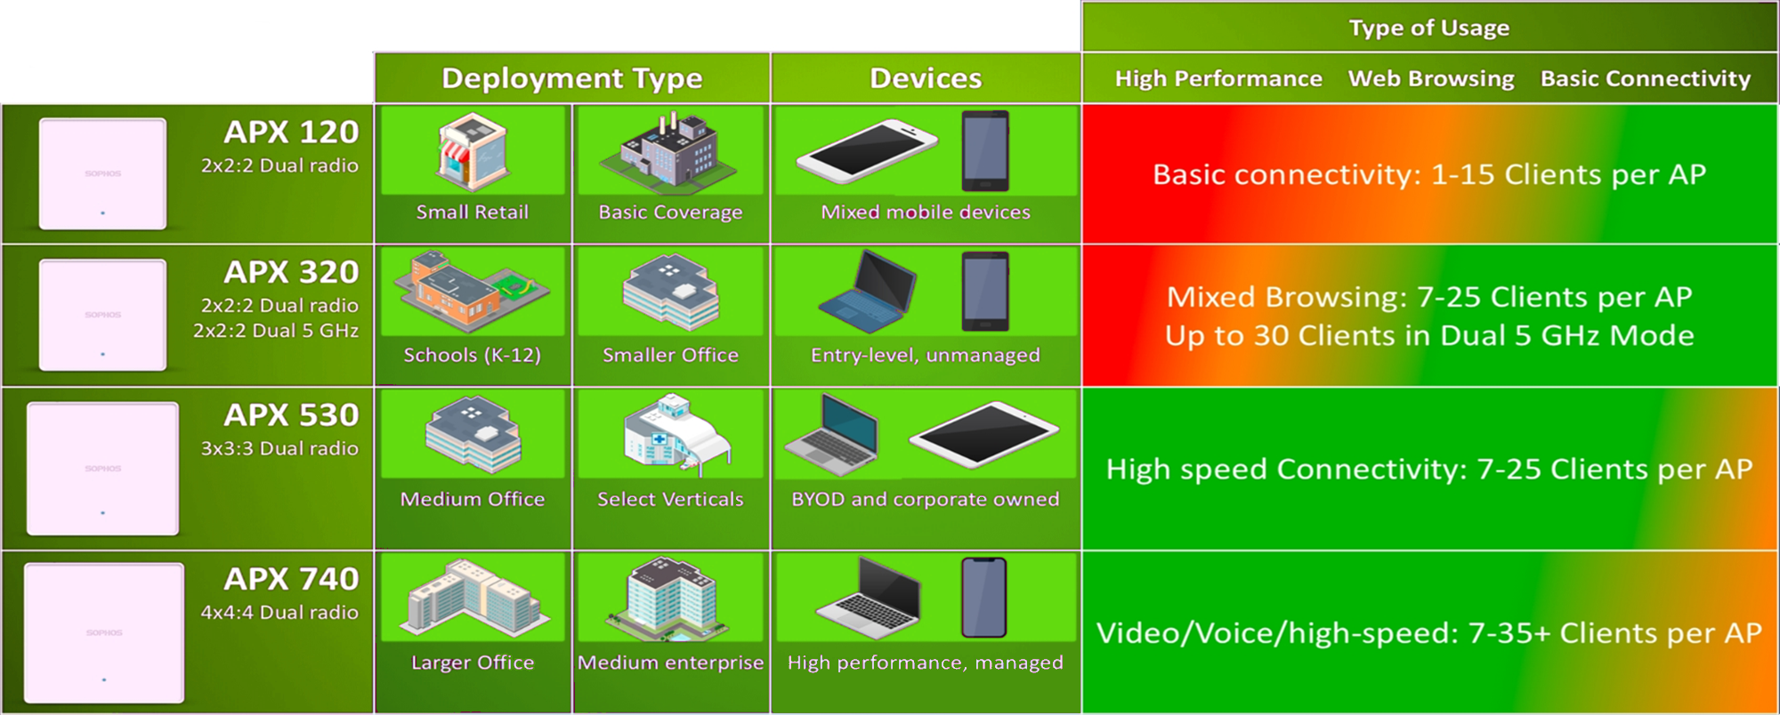
Secure Employee Facing Wi-Fi
Back2Menu

Slide 55
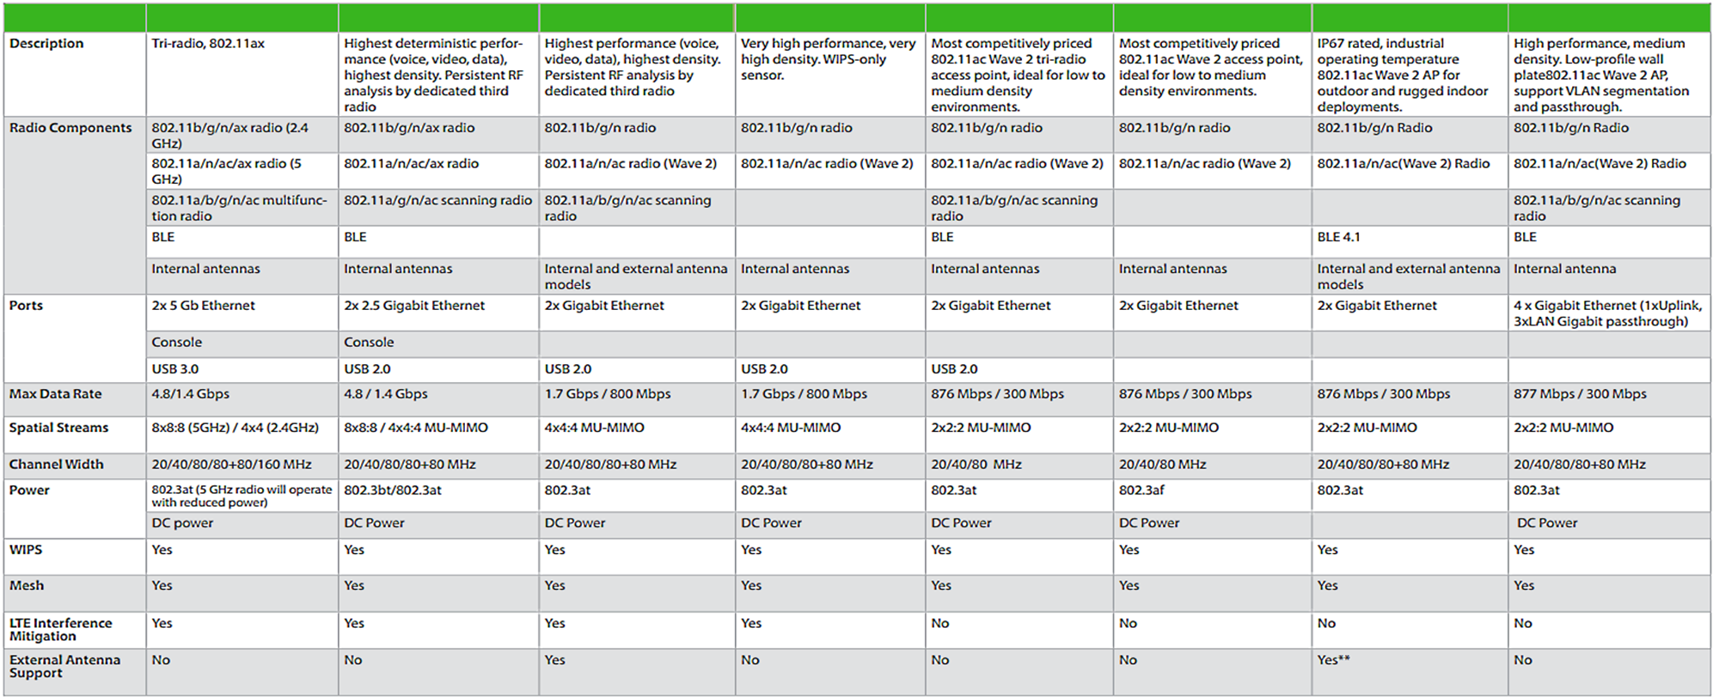
Customer’s Customer Facing Wi-Fi
Back2Menu

Slide 56

Infrastructure Wi-Fi - Access Point U6 Enterprise
C-260
C-250
C-130/E
C-120
C-110
C-100
C-105/E
W-118
Powerful, ceiling-mounted Wi-Fi 6E access point designed to provide seamless, multi-band coverage within high-density client environments.
Features:
Wi-Fi 6 support (2.4/5/6 GHz bands)
10.2 Gbps aggregate throughput rate
(1) 2.5GbE RJ45 port (PoE In)
Powered with PoE+
Prerequisite
Requires Unifi Dream Machine
TSaaS only offering
Back2Menu

Slide 57

Infrastructure Wi-Fi - Access Point U6 Extender
Model Number
C-260
C-250
C-130/E
C-120
C-110
C-100
C-105/E
W-118
The UniFi6 Extender (U6 Extender) is a portable, easy-to-deploy Wi-Fi 6 access point that can instantly broaden your home or office's wireless coverage. With its dual-band design and 5.3+ Gbps aggregate throughput rate, the U6 Extender delivers the strong, reliable connectivity needed to support even the most device-dense networks. Engineered for plug-and-play simplicity, this access point fits any standard US duplex wall outlet, and its compact frame allows you to strengthen your signal without cluttering your space or disrupting its aesthetic. The U6 Extender can be adopted to your network in a matter of minutes and centrally managed with either the UniFi Network web application or mobile app.
Features:
Dual-band Wi-Fi 6 connectivity
5 GHz band (4x4 MU-MIMO and OFDMA) with up to a 4.8 Gbps throughput rate
2.4 GHz band (2x2 MU-MIMO and OFDMA) with up to a 573.5 Mbps throughput rate
Fits any standard US duplex wall outlet
Prerequisite
Requires Unifi Dream Machine
TSaaS only offering
Back2Menu

Slide 58
Infrastructure Wi-Fi - Access Point U6 Pro
C-120
Model Number
C-130/E
C-120
C-130/E
W-118
C-100
W-118
C-260
C-100
C-260
C-250
C-250
C-110
C-110
C-105/E
C-105/E
High-performance, ceiling-mounted Wi-Fi 6 access point designed for large offices.
Features:
Wi-Fi 6 support (2.4/5 GHz bands)
5.3 Gbps aggregate throughput rate
(1) GbE RJ45 port (PoE In)
Prerequisite
Requires Unifi Dream Machine
TSaaS only offering
Back2Menu

Slide 59
Infrastructure Wi-Fi - Access Point U6 Lite
C-120
Model Number
C-130/E
C-120
C-130/E
W-118
C-100
W-118
C-260
C-100
C-260
C-250
C-250
C-110
C-110
C-105/E
C-105/E
Compact, dual-band Wi-Fi 6 access point with flexible mounting options.
Features:
5 GHz Wi-Fi 6 band, 2.4 GHz Wi-Fi 4 band
1.5 Gbps aggregate throughput rate
Focused antenna pattern for optimal ceiling or wall mounting
(1) GbE RJ45 port (PoE In)
Prerequisite
Requires Unifi Dream Machine
TSaaS only offering
Back2Menu

Slide 60
Infrastructure Wi-Fi - Access Point U6+
C-120
Model Number
C-130/E
C-120
C-130/E
W-118
C-100
W-118
C-100
C-260
C-100
C-260
C-260
C-250
C-250
C-250
C-110
C-110
C-110
C-105/E
C-105/E
C-105/E
A compact, PoE-powered access point improving upon the U6 Lite by bringing higher performance and dual-band WiFi6 support. Ideal for small and medium-sized businesses.
Features:
Dual-band Wi-Fi 6 support (2.4/5 GHz)
3.0 Gbps aggregate throughput rate
(1) GbE, PoE RJ45 Input
Prerequisite
Requires Unifi Dream Machine
TSaaS only offering
Back2Menu

Slide 61
Infrastructure Wi-Fi - Access Point U6+ Long-Range
Model Number
C-260
C-250
C-130/E
C-120
C-110
C-100
C-105/E
W-118
A long range WiFi6 access point offering increased power efficiency and more compact form factor compared with the U6 LR.
Features:
Dual-band Wi-Fi 6 support (2.4/5 GHz)
Improved antenna gain and increased MIMO support
3.0 Gbps aggregate throughput rate
(1) GbE, PoE RJ45 Input
Prerequisite
Requires Unifi Dream Machine
TSaaS only offering
Back2Menu

Slide 62
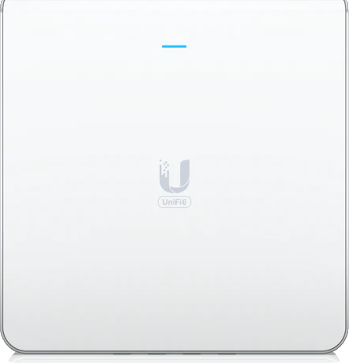
Infrastructure Wi-Fi - Access Point U6 Enterprise In-Wall
C-120
Model Number
C-120
Model Number
C-130/E
C-130/E
W-118
C-100
W-118
C-260
C-100
C-260
C-250
C-250
C-110
C-110
C-105/E
C-105/E
Sleek, wall-mounted Wi-Fi 6E access point with an integrated four-port switch designed for high-density office networks.
Features:
Wi-Fi 6 support (2.4/5/6 GHz bands)
10.2 Gbps aggregate throughput rate
4-port Gigabit switch with (1) PoE output
(1) 2.5GbE RJ45 port (PoE In)
Powered with PoE+ or PoE++ (required for PoE output)
Prerequisite
Requires Unifi Dream Machine
TSaaS only offering
Back2Menu

Slide 63
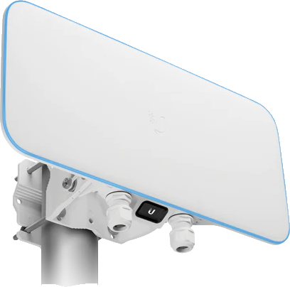
Infrastructure Wi-Fi - BaseStation XG
Quad-radio, 802.11ac Wave 2 access point with a powerful beamforming antenna designed to support large venues and high-density networks.
The Wi-Fi BaseStation XG (UWB XG) is a high-capacity, 802.11ac Wave 2 access point with (4) 5 GHz (4x4 MU-MIMO) radios, including (3) client-dedicated ones and (1) for persistent internet threat management. The powerful UWB XG can reach a 5.2 Gbps aggregate throughput rate and supports up to 1,500 clients. This access point is powered by PoE++ and features (1) GbE RJ45 port and (1) 10GbE ICM Ethernet port to facilitate a range of connections. The UWB XG can be set up in minutes and fully managed with the UniFi Network web application or mobile app.
Features:
(4) 5 GHz (4x4 MU-MIMO) radios [(3) 802.11ac Wave 2 radios for clients, (1) for network security]
5.2 Gbps aggregate throughput rate over the 5 GHz band
1,500-client limit
Beamforming antenna
Powered by PoE++ (PoE injector included)
(1) GbE RJ45 port
(1) 10GbE ICM Ethernet port
Prerequisite
Requires Unifi Dream Machine
TSaaS only offering
C-120
C-120
Model Number
C-120
Model Number
Model Number
C-130/E
C-130/E
C-130/E
W-118
W-118
C-100
W-118
C-100
C-260
C-100
C-260
C-260
C-250
C-250
C-250
C-110
C-110
C-110
C-105/E
C-105/E
C-105/E
Back2Menu

Slide 64

Infrastructure Wi-Fi - Building-to-Building Bridge
C-120
C-120
C-130/E
C-120
C-130/E
C-130/E
W-118
W-118
C-100
W-118
C-100
C-110
C-100
C-110
C-110
C-105/E
C-105/E
C-105/E
Model Number
Model Number
Model Number
C-260
C-260
C-260
C-250
C-250
C-250
60 GHz PtP link using 802.11ad with 5 GHz radio for backup. Ideal for high-throughput connectivity with a range of up to 500 m.
1.7+ Gbps bi-directional Plug and Play 60 GHz Bridge with 5 GHz Radio Redundancy, UniFi Application Management, and range of up to 500 m.
UniFi® Building-to-Building Bridge is the ideal solution for short-range, high-throughput connectivity. Integration with the UniFi application makes bridging two networks seamless. As a pack of two radios, UniFi Building-to-Building Bridge contains everything you need to get up and running within minutes. Enjoy simple, easy-to-use gigabit connectivity anywhere.
Features:
5 GHz Wi-Fi 6 band, 2.4 GHz Wi-Fi 4 band
1.5 Gbps aggregate throughput rate
Focused antenna pattern for optimal ceiling or wall mounting
(1) GbE RJ45 port (PoE In)
Prerequisite
Requires Unifi Dream Machine
TSaaS only offering
Back2Menu

Slide 65
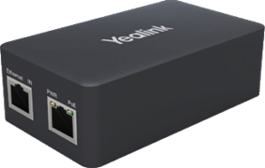
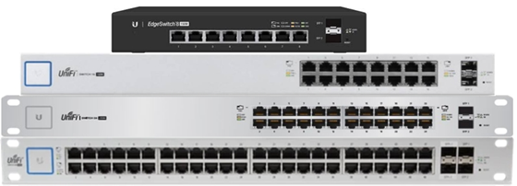
Wireless Power Options
Option #2 – 8,16,24 & 48 PoE+ Switch
Back2Menu

Slide 66





What is Hosted Voice?
With analog phone systems, one phone is connected to another via a PSTN (Public Switched Telephone Network). The phone uses electrical signals to generate audio in the speaker at the receiving end.
Hosted Voice, on the other hand, transfer voice data over the internet.
It starts with an IP Phone that turns your live voice communication into data packets. Unlike an on-site VoIP solution, the data packet first travels to one of many data centers.
If you already have a PBX in place, you maybe able to take advantage of VoIP features with SIP Trunking.
Back2Menu

Slide 67


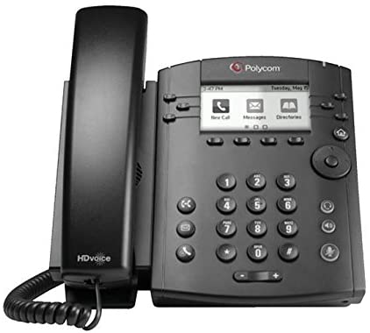
VVX 311 VoIP Phone
Entry point phone for Hosted Voice use
***Only for MACDs ***
Back2Menu

Slide 68
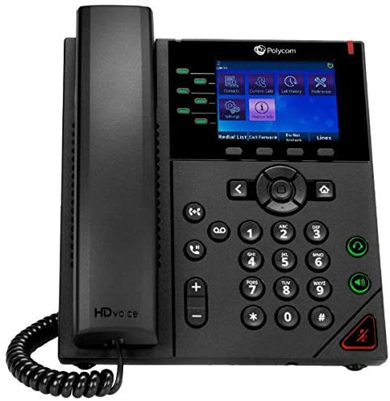
VVX 350 VoIP Phone
Entry Point IP Phone for Hosted Voice use
Back2Menu

Slide 69
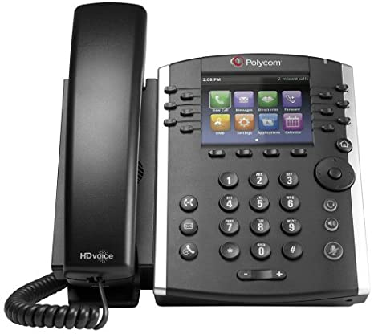
VVX 411 VoIP Phone
Mid-Point IP Phone for Hosted Voice use
Back2Menu

Slide 70
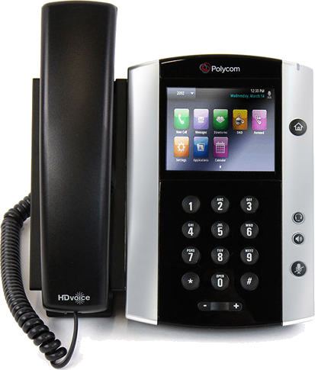
VVX 500 VoIP Phone
Higher End IP Phone for Hosted Voice use
Back2Menu

Slide 71
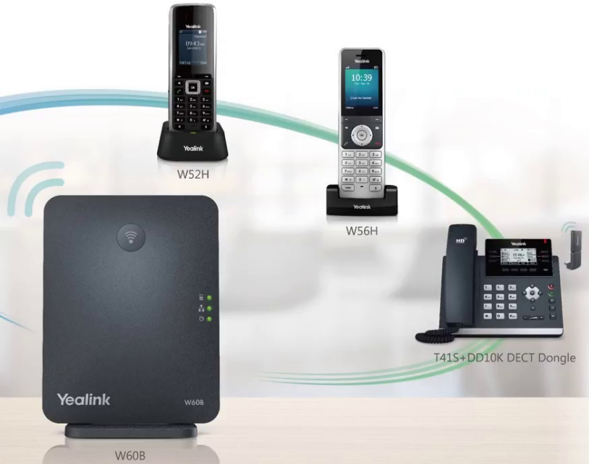
W60B, W56H, T41S+DD10K
For Hosted Voice use
***Can over-subscribe HV seats***
Back2Menu

Slide 72


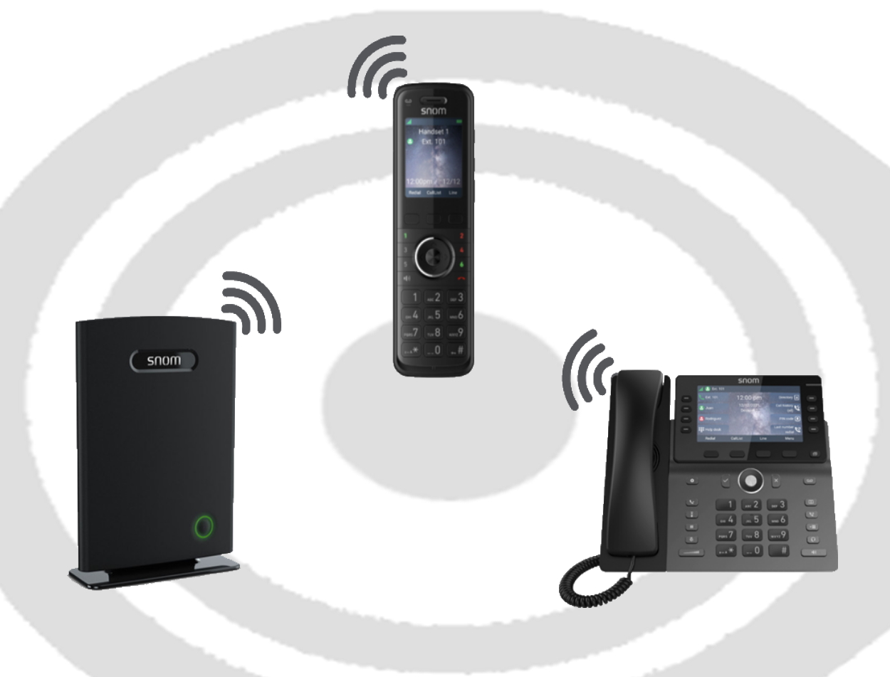
SNOM DECT Key System
DECT Key System Emulation
M500 Base Station (pair 2 for 16 Handsets)
M55 Cordless Handsets
M58 Cordless Desktop
Place up to (6) calls on hold via clear color-coded graphics that allows anyone to picked up the call from any phone.
No need to learn how to park and retrieve calls as in traditional hosted voice offerings.
Offering a total 16 Hand-sets / Call Paths.
(2) Intercom paging zones
For Hosted Voice use
***Can over-subscribe HV seats***
Back2Menu

Slide 73
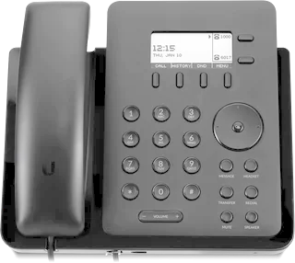
Flex VoIP Phone
Features:
2.57’’ display
Traditional physical button interface.
Call functions: 3-way conference, warm transfer, mute, hold, forward, redial, call waiting, voicemail
Handset and hands-free speakerphone mode
Wall-mountable
Powered by PoE and connects to a UniFi OS Console via Ethernet
Prerequisite
Requires Unifi Dream Machine
TSaaS only offering
Entry point phone for Hosted Voice use
***Only For Use With UniFi Dream Machine offerings***
Back2Menu

Slide 74
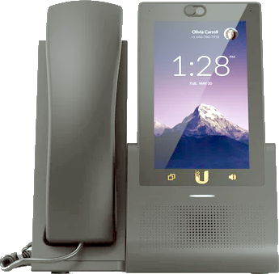
Touch VoIP Phone
Features:
5” HD color touchscreen
5MP Camera
Call functions: conference, warm/cold transfer, mute, hold, forward, call waiting, voicemail, internal video calls
Handset, hands-free speakerphone mode, and Bluetooth headset support
UniFi Protect support with on-screen camera streaming
Remote door unlocking with UniFi Identity
Powered by PoE and connects to a UniFi OS Console via Ethernet or Wi-Fi
Prerequisite
Requires Unifi Dream Machine
TSaaS only offering
Mid-Point IP Phone for Hosted Voice use
***Only For Use With UniFi Dream Machine offerings***
Back2Menu

Slide 75
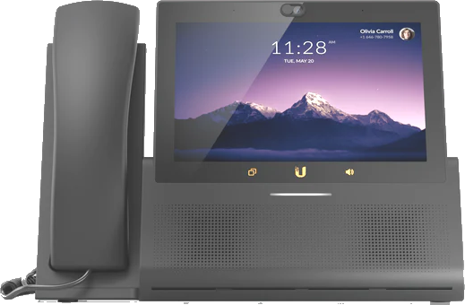
Touch Max VoIP Phone
Features:
7” HD color touchscreen
5MP Camera
Call functions: conference, warm/cold transfer, mute, hold, forward, call waiting, voicemail, internal video calls
Handset, hands-free speakerphone mode, and Bluetooth headset support
UniFi Protect support with on-screen camera streaming and Multi-View grid
Remote door unlocking with UniFi Identity
Powered by PoE+ and connects to a UniFi OS Console via Ethernet or Wi-Fi
Prerequisite
Requires Unifi Dream Machine
TSaaS only offering
Higher End IP Phone for Hosted Voice use
***Only For Use With UniFi Dream Machine offerings***
Back2Menu

Slide 76
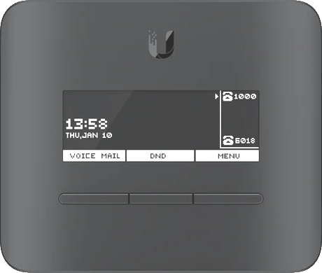
Talk VoIP ATA
Features:
Analog Telephone Adapter for telephone & fax
Supports up to two analog devices with respective numbers
Supports fax passthrough using G.711
Headset functionality for the primary line
Included magnet flat mount, wall mount, and angled desktop stand
Powered by the included USB-C adapter or PoE
Connects to a UniFi OS Console via Ethernet or automatically with UniFi Wi-Fi
Prerequisite
Requires Unifi Dream Machine
TSaaS only offering
For use for existing devices that need analog handoff
***Only For Use With UniFi Dream Machine offerings***
Back2Menu

Slide 77


Contact Center
Empower companies to continuously improve customer experience. With enterprise-class performance and consumer-like experience, Talkdesk allows you to adapt your contact center to the evolving needs of your customers and teams, resulting in increased productivity, customer satisfaction and cost savings.
Contact Center's Integrations
Connect your teams to the unique tools they use every day, while you maintain global visibility. 30+ out-of-the-box CRM / helpdesk integrations and a full suite of APIs allow you to maximize every customer interaction with quick access to the right contextual information.
Contact Center’s AppConnect
AppConnect unites best-in-breed software to redefine the way businesses integrate their call center platform.
Back2Menu

Slide 78
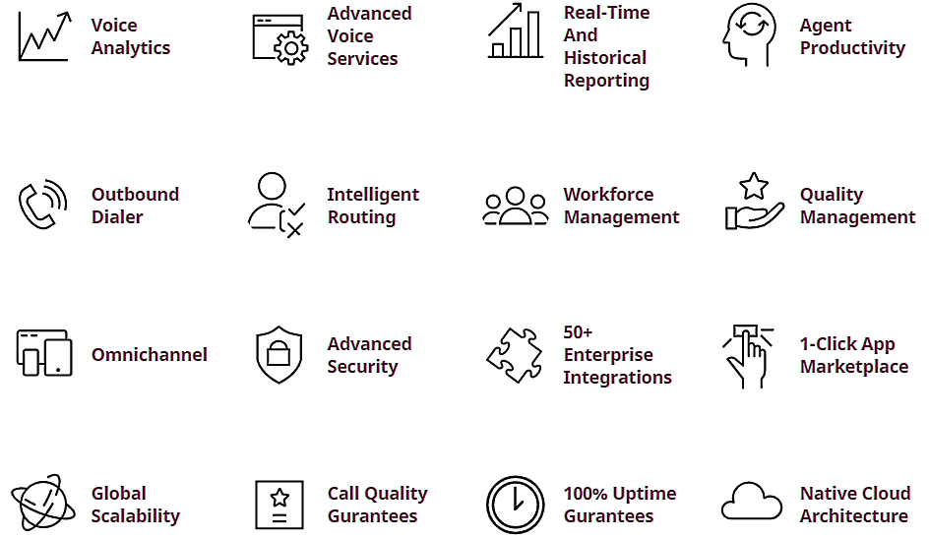
Key Features
Back2Menu

Slide 79
What are the Main Advantages of Direct Routing?
Seamless calling from within MS Teams - desktop, mobile, endpoint
Advanced calling features - voice mail, forwarding, hunt groups, auto-attendant
Instant access to your contacts - uses MS Teams contact list
One-click meeting creation
Collaborate with both internal and external users at the same time
BULLSEYE VOICE DIFFERENCE
MS TEAMS POWER OPTIONS
Back2Menu

Slide 80

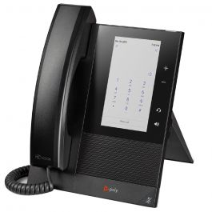
CCX 400 MS Teams Phone
Entry Level IP Phone for MS Teams
Back2Menu

Slide 81
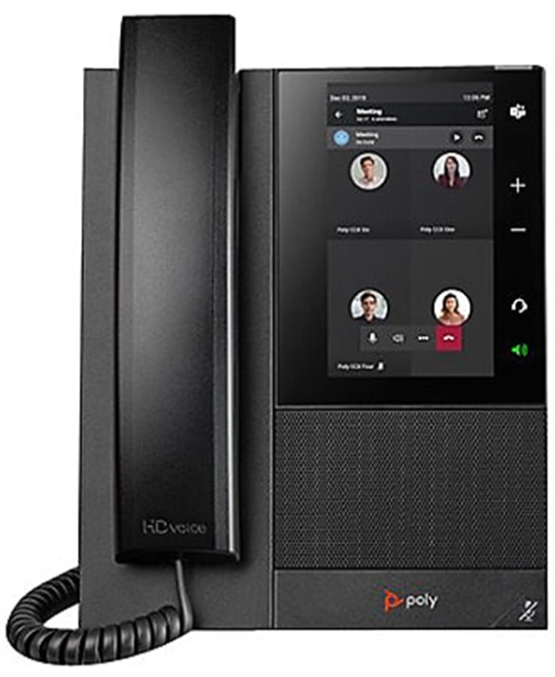
CCX 500 MS Teams Phone
Mid-level IP Phone for MS Teams
Back2Menu

Slide 82
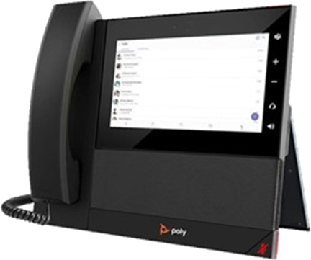
CCX 600 MS Teams Phone
Upper-end IP Phone for MS Teams
***Has built-in Camera***
Back2Menu

Slide 83
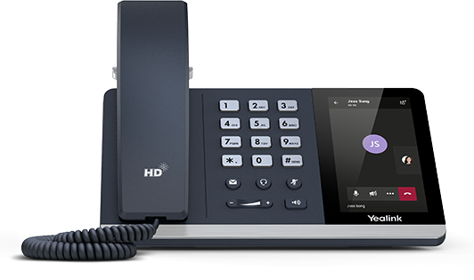
T55A MS Teams Phone
Entry Level IP Phone for MS Teams
Back2Menu

Slide 84
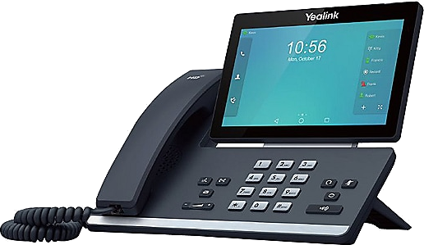
T58A MS Teams Phone
Mid-level IP Phone for MS Teams
Back2Menu

Slide 85
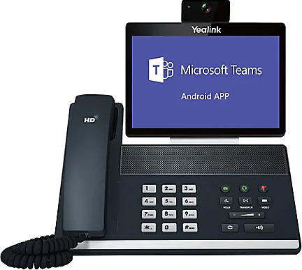
VP59 MS Teams Phone
Upper-end IP Phone for MS Teams
***Has built-in Camera***
Back2Menu

Slide 86



The BullsEye Difference
Voice Readiness Test with True Moss Score
Traffic Shaping Edge Device (8:1 Ratio)
Virtual Tech (BNA)
Back2Menu

Slide 87
Voice Power Options
Option #2 – 8,16,24 & 48 PoE+ Switch
Back2Menu

Slide 88


INTEGRATED VOICE (IP-PRI, SIP Trunks, Analog handoff)
Analog Handoff
IP-PRI Handoff
SIP Trunk Handoff
Back2Menu

Slide 89



Grandstream Handy Tone 812 ATA
Analog Telephone Adapter
For use with Integrated Voice
(1) LAN RJ-45 port
(1) WAN RJ-45 port
(2) RJ-11 ports
Back2Menu

Slide 90

Grandstream Handy Tone 818 ATA
Analog Telephone Adapter
For use with Integrated Voice
(1) LAN RJ-45 port
(1) WAN RJ-45 port
(8) RJ-11 ports
Back2Menu

Slide 91


Adtran 908 for ATA
Powered by
Analog Telephone Adapter
For use with Integrated Voice
(1) WAN RJ-45 port
(24) ports via Amphenol cable & 66-block
Back2Menu

Slide 92


What is SIP Trunking?
Powered by
SIP Trunking enables the end point’s PBX to send and receive calls via an IP network, such as the Internet or private WAN. As SIP is applied for the signaling protocol for multiple real-time application, SIP trunk is able to control voice, video and messaging applications.
Can be delivered over an existing broadband connection
Empowers companies with significant productivity-enhancing benefits
Reduced costs through convergence of voice and data
Seamless integration with existing IP PBX system
Scalable growth supported with the addition of new trunks
Uses proprietary, BGP gateways to ensure maximum performance
Eliminate waste when you pool and burst call paths across multiple locations
Delivers voice and data traffic over a single dynamic broadband pipe
Connects from BullsEye Telecom digital voice platform to existing IP PBX
Customized flexible calling plans to meet unique calling requirements
Back2Menu

Slide 93
What is IP-PRI?
PRI stands for Primary Rate Interface — a traditional means of communication able to carry 23 concurrent calls. IP-PRI is one of the latest evolutions of TDM-PRI.
IP-PRI vs TDM-PRI
TDM-PRI is a copper-based voice solution that only carries 23 analog voice channels, while IP-PRI allows you to choose as many voice channels you want — similar to the functionality of SIP Trunking — and keep the network that you’re on. For an IT specialist, IP-PRI makes it easier to monitor phone and internet service, since TDM-PRIs are a standalone circuit.
BullsEye’s IP-PRIs have an IP to TDM gateway — a piece of networking equipment that is able to convert session initiation protocol (SIP) signaling into PRI.
Back2Menu

Slide 94
908 for IP-PRI
IP-PRI Adapter
For use for IP-PRI
(1) WAN RJ-45 port
(1) IP-PRI port
Back2Menu

Slide 95
POTS ALTERNATIVE
Back2Menu

Slide 96

POTS ALTERNATIVE - FIRE, LIFE & SAFETY
GTM Strategy
For use with Integrated Voice
Voice Service Alternative
Supplemental to BullsEye VoIP solution
Lines that would have been left on the LEC: Fire, Life, Safety
Secondary as Voice replacement
Key Capabilities
Comprehensive Technology.
Redundancy: Wireless backup (VZ Only).
Fire, Security, Elevator, POS, Fax, etc.
Simple POTS
E911
Components
2 Line Minimum
Price Elements:
Box (Includes Warrantee)
Wireless Back-up (1g plan)
Seat License (FXS, FLS)
Install
Back2Menu

Slide 97

Walk Away From The HIGH Price of Old Copper POTS Lines and Move to BullsEye’s POTS Alternative Solutions
The Advantage:
Reduce expensive capex investment
Create immediate, significant savings
Streamline your business infrastructure
Future-proof against sun-setting POTS lines
Full Redundancy and failover Options
Compliance with NFPA 72 (National Fire Alarm and Signaling Code)
Compliance with UL-864 (Standard for Control Units and Accessories for Fire Alarm Systems)
A Managed Facility Voice Network (MFVN) device ensures the service quality and reliability from your location to the PSTN or other MFVN peer network
Back2Menu

Slide 98

Walk Away From The HIGH Price of Old Copper POTS Lines and Move to BullsEye’s POTS Alternative Solutions
The Advantage:
Reduce expensive capex investment
Create immediate, significant savings
Streamline your business infrastructure
Future-proof against sun-setting POTS lines
Full Redundancy and failover Options
Compliance with NFPA 72 (National Fire Alarm and Signaling Code)
Compliance with UL-864 (Standard for Control Units and Accessories for Fire Alarm Systems)
A Managed Facility Voice Network (MFVN) device ensures the service quality and reliability from your location to the PSTN or other MFVN peer network
Back2Menu

Slide 99

VoIP Service offered via our Cable partners
  Comcast
  Spectrum
  Cox
Great alternative to traditional POTS due to costs or our inability to assume services that are out of our traditional POTS footprint,
Like our be-ALERT solution, FLS lines left behind on VoIP solutions or within our base are prime candidates.
  Lead with be-UCaaS for traditional voice (POTS) alternative.
  Lead with be-LINC for FLS lines (due to cost and speed of deployment)
Perfect for those POTS lines that we are unable to migrate or those where there are high POTS rates (line and/or features).
Provides price stability and ease of migration on existing Broadband connections or easily installed with a new Broadband circuit.
Back2Menu

Slide 100
How it Works
Provider Network
Back2Menu

Slide 101


Equipment
All carriers offer the same make of eMTA (embedded Multimedia Terminal Adapter), but with some differing models, features, and functions, as well as how they deploy it.
Multiple eMTAs can be installed at a location to support up to 18 lines. (Check with BullsEye SE)
Back2Menu

Slide 102
Details
Delivered as VoIP calls over managed IP voice network.
Each line comes with unlimited domestic outbound calling.
Inbound & Outbound calling is fully integrated to the Public Switched Telephone Network (PSTN).
Phone & Utility Lines are NFPA-72 Compliant, with National Fire Protection Association standards.
Built-in 8 Hour Battery backup
Back2Menu

Slide 103

Standard Features
COMCAST | COX | SPECTRUM
Caller ID | Caller ID | Caller ID
Call Forwarding | Call Forwarding | Call Forwarding
Call Transfer | Call Transfer | Call Transfer
 | 3-Way Calling | 3-Way Calling
 | Speed Dial | Speed Dial
 | Call Return
 | Call Waiting
 | Do Not Disturb
Call Hold | Flash Call Hold
 | Last Number Redial
 | Anonymous Call Rejection
 | Directed Call Pickup
 | Priority Alert
 | Selective Call Acceptance
 | Selective Call Rejection
 | Simultaneous Ring Personal
 | Speed Dial 100
 | Speed Dial 8
Call Park | Call Park
 | Call Pickup
 | Incoming Call Plan
 | Series Completion
 | Feature Access Codes
Conference Calling
Extension Dialing
Hunt Groups
Customized Caller ID
Call Forward Unreachable
Back2Menu

Slide 104

Additional Features
FEATURES | COMCAST | COX | SPECTRUM
Directory Listing: | 1 Free Directory Listing | 1 Free Directory Listing | 1 Free Directory Listing
Additional Fee: | Voicemail | Voicemail | Voicemail
International: | Default to Blocked | Default to Blocked | Default to Blocked
Ability to PIC to BTI: | Yes | Yes | Yes
Other Blocking: | 10-10, 900, 976, 700, 500 numbers, inbound collect and chargeable calls to 3rd parties. | 10-10, 900, 976, 700, 500 numbers, inbound collect and chargeable calls to 3rd parties. | 10-10, 900, 976, 700, 500 numbers, inbound collect and chargeable calls to 3rd parties.
Back2Menu

Slide 105
MISCELLANEOUS SERVICES
Back2Menu

Slide 106



Miscellaneous Services
E-RATE - UNIVERISAL SERVICE PROGRAMS
BULLSEYE REBILLING - INVOICE INTEGRATION
Back2Menu

Slide 107




SECURE CLOUD FAX
BULLSEYE UCAAS FAX
BULLSEYE VOIP FAX
TRADITIONAL POTS FAX
Back2Menu

Slide 108
Secure Cloud Fax
Tired of replacing toner and buying paper for faxes? Want to better protect your data, reduce your eco-footprint, and lower faxing costs? BullsEye Telecom’s Secure Cloud Fax, powered by eFax Corporate®, lets you send and receive faxes anywhere using cloud faxing.
Secure Cloud Fax is a simple, reliable fax solution that allows you to enjoy significant cost savings. With Secure Cloud Fax, your faxes are sent straight to your email, keeping them private, confidential, and secure. Choose from multiple cloud-based plan options that are scalable and flexible to meet your exact needs.
Our easy-to-use web portal is accessible via PC, Mac, and mobile
Email
Multi-function printers
Online web portal
Desktop, smartphone, or tablet apps
Back2Menu

Slide 109
UCaaS Fax
The Fax to E-Mail Upgrade option allows Fax (T.38) messages are converted to TIFF e-mail documents and delivered to the user’s mail server via SMTP. From there they may be viewed, printed, or forwarded to another user.
Blending fax messaging with the voice messaging service, broadens the Unified Messaging capabilities of BullsEye VoIP offerings to provide end-users with the flexibility to use and manage their messages from any location that can access their e-mail system.
With the Fax to E-Mail messaging service, users can send faxes to group distribution lists in a manner similar to the use of e-mail distribution lists. Because fax messaging are routed as e-mail attachments, users minimize the need for physical fax machines and phone lines dedicated to fax use.
The fax capability also leverages VoIP globalization, enabling end-users with distributed locations-such as frequent business travelers or businesses with multiple offices-to maintain a fax number in one country and receive faxes in other parts of the world as they travel.
Back2Menu

Slide 110
VoIP Fax
You don’t have to change your phone system to improve the way your business communicates. Get the best of both worlds with BullsEye VoIP Fax. Better value, more flexibility, robust features, and real-time failover. That’s how BullsEye does phone service! Installed by BullsEye’s white glove technicians across the U.S., Integrated Voice & Fax brings new life to existing phone systems by adding cutting-edge VoIP features and central management.
Our easy-to-use web portal is accessible via PC, Mac, and mobile
BullsEye's voice network is powered by BroadSoft, the industry leader in cloud unified communications
Noninvasive troubleshooting and VoIP-readiness testing
Inside wiring services available Industry-leading technology, deployed by expert BullsEye technicians
24x7 support and advice when you need it most, provided by BullsEye’s Expert Network Center
Back2Menu

Slide 111
Traditional
Traditional Fax Lines are POTS phone lines that are attached only to a fax machine.
Check for availability…less & less true POTs (Copper) options. Should be looking at migrating to VoIP options, such as hosted voice, integrated voice, or POTs-in-a-Box replacement (EPIK)
Back2Menu

Slide 112

Technical Support as a Service
Are you Facing These Challenges?
Employees on-site that lack the skill set to perform this work
Budget or time to send employees to other sites
A way to contract qualified technicians in the areas where you operate
Knowledge to write a scope of work to get the work completed
Time to research local talent
Onboarding newly acquired locations
Applications for TSaaS
Site Surveys
Wiring new buildings for Ethernet
Replacing UPS batteries
Fiber Optic Extensions
Installing Home Theater/Audio Visual
PC replacement
Printer installation
Mounting Webcams
Electrical work
Replacing automatic door
Alarm system installation
Kiosk installation
Onboarding newly acquired locations
Point of Sale (POS) installation
Back2Menu

Slide 113
E-Rate: Universal Service Program for Schools and Libraries
BullsEye’s The Federal Communications Commission (FCC) offers an E-Rate program designed to make telecommunications and information services more affordable for public K-12 schools, private non-profit schools, public libraries, school libraries, non-instructional facilities, and selected non-traditional educational facilities. Specific eligibility is determined by the FCC.
The FCC, Universal Service Administrative Company (USAC), and USF work together to provide the assistance to schools and libraries. USAC manages the program with funding from the Universal Service Fund (USF) (fcc.gov/general/universal-service-fund).
The E-Rate program provides discounts to eligible schools, libraries, and selected educational facilities ranging from 20 to 90 percent on qualifying telecommunications services and Internet access as well as certain connectivity management/maintenance costs.
If demand for E-Rate money is greater than the available funds, funding is allocated first to the highest poverty schools and libraries, then the next-highest poverty applicants, and so on.
Back2Menu

Slide 114
BullsEye’s Rebilling - Invoice Integration
BullsEye’s Rebilling/Invoice Integration gives you greater control of all your business communication services and delivers total visibility and accountability for each location on your BullsEye invoice.
Include your other business communications services in your BullsEye Telecom account hierarchy
We take over payment, management and bills on our consolidated billing platform
Combine all your business communications services onto your BullsEye invoice
Implement Moves, Adds, Changes and Deletions (MACDs) to all locations
Redeploy your employee resources to revenue-generating functions
Write one check for all of your business communications services
Reduce risk of disconnection from late payment or lost invoices
Onboarding newly acquired locations
Track and trend you're invoicing to maximize savings
Identify any unused services or disparate charges
Report, manage and resolve issues
Reduce invoice processing fees
Back2Menu

Slide 115




A full onsite 4K IP Security Camera solution that is second to none. Indoor/outdoor HD PoE Security cameras with some of latest and greatest options, easy & intuitive web-based controls with onsite storage with cloud backup options and redundant power backup. All installed and support by a trusted partner, BullsEye.
Prerequisite
Requires Unifi Dream Machine
TSaaS only offering
Could Require Additional Network Recorder hardware base on video storage needs
Back2Menu

Slide 116

- AI 360
Indoor/outdoor HD PoE camera with pan-tilt-zoom functionality that offers full 360° surveillance.
Features:
Full HD, 30 FPS camera with a 5MP CMOS sensor
Ultra-wide, 360° fisheye lens
IPX4-rated, weatherproof casing
IK08-rated tamper resistance
Built-in IR LEDs for nighttime surveillance
Prerequisite
Requires Unifi Dream Machine
TSaaS only offering
Could Require Additional Network Recorder hardware base on video storage needs
Back2Menu

Slide 117

- AI BULLET
Night vision surveillance camera that captures 4MP video at 30 frames per second (FPS).
The Camera AI Bullet is a next-generation UniFi Protect camera that captures crisp 4MP (2688 x 1512) video at 30 FPS video over a Gigabit Ethernet connection. Equipped with infrared LEDs and an automatic IR cut filter, the camera also provides pristine nighttime video to deliver high-quality surveillance around the clock. The AI Bullet also features a built-in microphone to enhance your stream with crystal-clear audio. Designed to be versatile and simple to deploy, the AI Bullet comes with a flexible, three-axes ball joint that makes it easy to position the camera exactly where you need it. This PoE-powered camera can be adopted in minutes with the UniFi Protect web application or mobile app.
Features:
Streams 4MP (2688x1512) video at 30 FPS
Built-in IR LEDs and an automatic IR cut filter for enhanced night vision
Powered with PoE (37—57V DC)
Smart detection range: People (<10 m) / Vehicles (<20 m)
Prerequisite
Requires Unifi Dream Machine
TSaaS only offering
Could Require Additional Network Recorder hardware base on video storage needs
Back2Menu

Slide 118

- AI DSLR
Indoor/outdoor 4K PoE camera with astounding image quality. Featuring an advanced M43 DSLR prime lens (selectable 17mm wide angle or 45mm long distance).
Features:
10-megapixel Sensor delivering incredible color image quality
Ultra 4K photo and video
Two-way speaker with a built-in microphone
Multiple mounting options (wall, pole, and ceiling) or tripod
Prerequisite
Requires Unifi Dream Machine
TSaaS only offering
Could Require Additional Network Recorder hardware base on video storage needs
Back2Menu

Slide 119

- G4 PTZ
High-performance pan-tilt-zoom camera with 4K, 24 FPS video streaming, 22x optical zoom, and adaptive IR LED night vision.
The UniFi Camera G4 PTZ is a superior surveillance camera for shopping centers, parking lots, airports, train stations, and other transportation hubs. Pairing G4 PTZ’s advanced optical and video technologies with UniFi Protect’s ease of use creates a unique solution for the most demanding environments.
G4 PTZ comes with IP66 weatherproof casing and flexible powering options.
Features:
4K, 24 FPS video stream
22x optical zoom with F1.5 lens
Tamper-resistant pan and tilt with servo feedback
Multi-exposure HDR
Adaptive IR LEDs, night vision distance up to 100 m
Powered with PoE++
IP66 weatherproof rating
Operating temperature -40˚ to + 50˚C (-40˚ to +122˚F)
Managed with UniFi Protect application and mobile app
Prerequisite
Requires Unifi Dream Machine
TSaaS only offering
Could Require Additional Network Recorder hardware base on video storage needs
Back2Menu

Slide 120

- Doorbell Pro
Dual-camera, Wi-Fi-connected doorbell with an integrated porch light and night vision capability.
Features:
(1) 5MP, 24 FPS camera with infrared LEDs
(1) 8MP, 2 FPS camera for package observation
Two-way audio
IPX4-rated, weather-resistant casing
Includes multiple mounting options and a chime power kit
Prerequisite
Requires Unifi Dream Machine
TSaaS only offering
Could Require Additional Network Recorder hardware base on video storage needs
Back2Menu

Slide 121

- AI THETA
The world’s first security camera system designed for interior design professionals
Features:
Versatile, discreet camera with interchangeable 8/12MP lenses
Two-way audio*
Advanced processing engine for long-range smart detection
Color LCM display for device status monitoring
Prerequisite
Requires Unifi Dream Machine
TSaaS only offerin
Could Require Additional Network Recorder hardware base on video storage needs
Back2Menu

Slide 122

- VID RECORDER
A video recorder with (4) 2.5/3.5" HDD bays that can support up to 30 days of storage for (15) 4K cameras or (50) Full HD cameras.
Features:
(1) 10G SFP+ port
(1) GbE RJ45 port
Automatic HDD RAID configuration for data redundancy
Connects to a Power Backup for enhanced power redundancy
Prerequisite
Requires Unifi Dream Machine
TSaaS only offering
Back2Menu

Slide 123

- VID RECORDER PRO
A 2U-sized video recorder with (7) 2.5/3.5" HDD bays that can provide up to 60 days of storage for (20) 4K cameras or (60) Full HD cameras.
Stack multiple UNVR Pros* to increase your storage capacity and accommodate large security camera systems.
Features:
(1) 10G SFP+ port
(1) GbE RJ45 port
1.3" touchscreen for video previewing
Automatic HDD RAID configuration for data redundancy
Connects to a Power Backup for enhanced power redundancy
Prerequisite
Requires Unifi Dream Machine
TSaaS only offering
Back2Menu

Slide 124

POWERED offers several options that can be used stand alone or combined to add more backup power capacity. Start with what you consider your most mission critical devices that must continue to have power.
Prerequisite
Requires Unifi Dream Machine
Options
Consider an optional Battery Maintenance Plan with our TSaaS department
Back2Menu

Slide 125

- MISSION CRITICAL
A nine-port, Layer 2 PoE switch with a 368Wh Lithium-ion backup battery to ensure uninterrupted power for critical networking devices.
Features:
(4) GbE, PoE+ RJ45 ports
(4) GbE, PoE++ RJ45 ports
(1) GbE RJ45 port
(2) 110V, AC power outputs for a gateway and modem
(1) DC terminal block for an external 48V DC battery
(External batteries not included, but offer a large power backup option when need)
Prerequisite
Requires Unifi Dream Machine
TSaaS only offering
Back2Menu

Slide 126

- SmartPower PDU Pro
The SmartPower PDU Pro is designed to power an entire rack-mounted UniFi system and give you the ability to remotely manage the system's ports.
Features:
(16) remotely resettable power outlets
Works with cable modems, DSL routers, and optical network terminals with a US AC plug and reboots them when they go offline
(3) GbE RJ45 ports reserved for virtual router redundancy
(4) USB-C ports (Max 2A per port, total 4A/20W power budget)
1.3" LCM color touchscreen
Prerequisite
Requires Unifi Dream Machine
TSaaS only offering
Back2Menu

Slide 127

- SmartPower RPS Pro
A backup power unit that provides full redundancy for rack-mounted UniFi devices.
Features:
1,250W total DC power supply
(8) USP DC ports for UniFi devices
(1) GbE RJ45 management port
(1) 110V AC port for an ISP modem
(1) 48V DC port for an external battery
Prerequisite
Requires Unifi Dream Machine
TSaaS only offering
Back2Menu

Slide 128

- SmartPower RPS Pro
950W backup power unit that provides full redundancy for rack-mounted UniFi devices.
Features:
950W total DC power supply
(6) USP DC ports
(1) GbE RJ45 port
1.3" LCM color touchscreen
Prerequisite
Requires Unifi Dream Machine
TSaaS only offering
Back2Menu

Slide 129

BullsEye’s Smart Connect empowers and restricts to all types on options your employees and your guests based on the rules you have configured.
Features:
UID – Employee Access Management for Physical & Virtual
Inter-active Touch Displays Access
Door & Gate Access Management
Connection Cast Access
Wi-Fi Access
Smart EV Station
Prerequisite
Requires Unifi Dream Machine
TSaaS only offering
Back2Menu

Slide 130

- 7” DISPLAY
7" HD PoE touchscreen designed for UniFi Connect
Optional Hardware Features:
UniFi Protect support (Kiosk mode locking, multi-cam grid-view)
Advanced digital signage capability
Ideal for interactive point-of-sale web application use cases
Included table stand
Multiple mounting options
Prerequisite
Requires Unifi Dream Machine
TSaaS only offering
Back2Menu

Slide 131

- 13” DISPLAY
13.3" Full HD PoE+ touchscreen designed for UniFi Connect
Optional Hardware Features:
UniFi Protect support (Kiosk mode locking, multi-cam grid-view)
Advanced digital signage capability
Ideal for interactive point-of-sale web application use cases
Included table stand
Multiple mounting options
Prerequisite
Requires Unifi Dream Machine
TSaaS only offering
Back2Menu

Slide 132

- 21” DISPLAY
21.5" Full HD PoE++ touchscreen designed for UniFi Connect
Optional Hardware Features:
UniFi Protect support (Kiosk mode locking, multi-cam grid-view)
Advanced digital signage capability
Ideal for interactive point-of-sale web application use cases
Multiple mounting options
Prerequisite
Requires Unifi Dream Machine
TSaaS only offering
Back2Menu

Slide 133
- 27” DISPLAY
27" Full HD PoE++ touchscreen designed for UniFi Connect
Optional Hardware Features:
UniFi Protect support (Kiosk mode locking, multi-cam grid-view)
Advanced digital signage capability
Ideal for interactive point-of-sale web application use cases
Multiple mounting options
Prerequisite
Requires Unifi Dream Machine
TSaaS only offering
Back2Menu

Slide 134


- CAST
Instantly transform any TV display into a powerful managed digital signage device.
The Connect Cast (UC Cast) is a portable, PoE-powered content broadcasting module that allows you to present custom multimedia playlists created in the UniFi Connect application on any HDMI-compatible display. The UC Cast can also be powered with the included USB-C adapter and is fully managed with UniFi Connect.
Optional Hardware Features:
Connects to any HDMI-compatible display
Presents multimedia playlists created in UniFi Connect
Powered with PoE or the included USB-C adapter
Prerequisite
Requires Unifi Dream Machine
TSaaS only offering
Back2Menu

Slide 135

- Access Control
BullsEye’s Smart Connect Access Control empowers and restricts your employees and your guests to all your physical doors and gates based on the rules you have configured while also keeping a detailed log with video clips of all who is coming and going.
Optional Hardware Features:
Access Hubs
Access Reader Pro
Access Reader Lite
Access Cards
Mobile Access Application
Prerequisite
Requires Unifi Dream Machine
TSaaS only offering
Back2Menu

Slide 136

- EV Station
Smart electric vehicle charging station designed for UniFi Connect.
The EV Station offers a variety of power management, charge scheduling, and access control features. It can be fully operated from its display or configured and monitored via UniFi Connect (web/mobile).
Features:
Charge scheduling
Authorized Use Only mode for tailoring user access
10.1" LCD display for at-a-glance charge monitoring
Wall mount included
Prerequisite
Requires Unifi Dream Machine
TSaaS only offering
Back2Menu

Slide 137
BullsEye Odds & Ends
E-RATE - UNIVERSAL SERVICE PROGRAMS
BULLSEYE REBILLING - INVOICE INTEGRATION
Back2Menu

Slide 138
E-Rate: Universal Service Program for Schools and Libraries
BullsEye’s The Federal Communications Commission (FCC) offers an E-Rate program designed to make telecommunications and information services more affordable for public K-12 schools, private non-profit schools, public libraries, school libraries, non-instructional facilities, and selected non-traditional educational facilities. Specific eligibility is determined by the FCC.
The FCC, Universal Service Administrative Company (USAC), and USF work together to provide the assistance to schools and libraries. USAC manages the program with funding from the Universal Service Fund (USF) (fcc.gov/general/universal-service-fund).
The E-Rate program provides discounts to eligible schools, libraries, and selected educational facilities ranging from 20 to 90 percent on qualifying telecommunications services and Internet access as well as certain connectivity management/maintenance costs.
If demand for E-Rate money is greater than the available funds, funding is allocated first to the highest poverty schools and libraries, then the next-highest poverty applicants, and so on.
Back2Menu

Slide 139
BullsEye’s Rebilling - Invoice Integration
BullsEye’s Rebilling/Invoice Integration gives you greater control of all your business communication services and delivers total visibility and accountability for each location on your BullsEye invoice.
Include your other business communications services in your BullsEye Telecom account hierarchy
We take over payment, management and bills on our consolidated billing platform
Combine all your business communications services onto your BullsEye invoice
Implement Moves, Adds, Changes and Deletions (MACDs) to all locations
Redeploy your employee resources to revenue-generating functions
Write one check for all of your business communications services
Reduce risk of disconnection from late payment or lost invoices
Onboarding newly acquired locations
Track and trend you're invoicing to maximize savings
Identify any unused services or disparate charges
Report, manage and resolve issues
Reduce invoice processing fees
Back2Menu

